Slide 1





Support to the Ministry of Education of the Republic of Azerbaijan for further adherence of the higher education system to the European Higher Education Area (AZ-ad-EHEA)
This project is funded by
the European Union

Slide 2
Table of Contents:
Institutional framework in a nutshell
Key personnel of the project
Proposed project description and methodology
Objectives of the training

Slide 3
FINEEC – Finnish Education Evaluation Centre
To evaluate activities of education and training providers and higher education institutions
To support education and training providers and HEIs
To develop evaluation of education

Slide 4
Operative principles
Decision-making independent of external influence
Follows the principle of enhancement-led evaluation
Actively disseminates the results of evaluations
From Pre-School to Higher Education
Full member of ENQA and EQAR

Slide 5
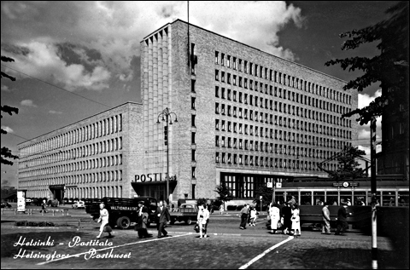
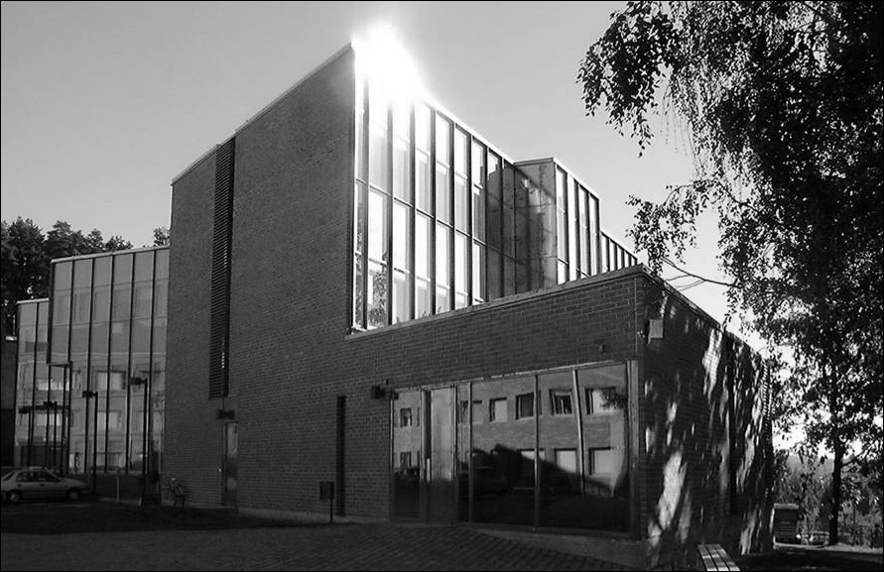
Operating in Helsinki and Jyväskylä
Total approx. 40 persons
Image: Gustav Welin, Museum of Finnish Architecture
Image: University of Jyväskylä

Slide 6
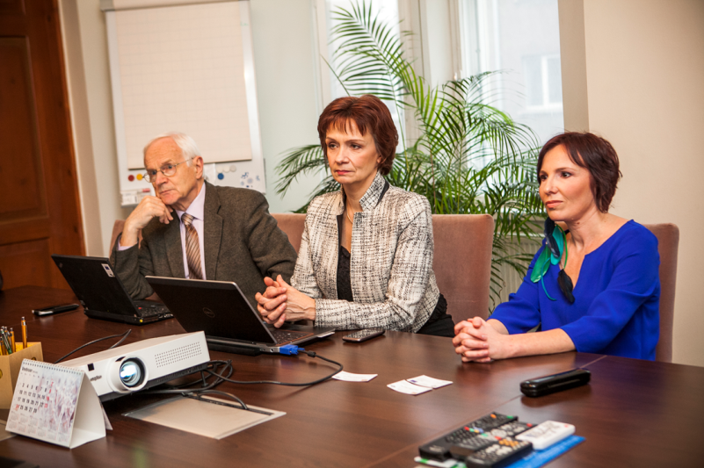

EKKA
Full member of ENQA and EQAR
EKKA’s mission is,
in cooperation with its partners,
to promote quality in the field of education
and thereby increase the competitiveness
of the Estonian society.

Slide 7
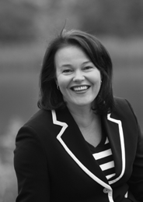
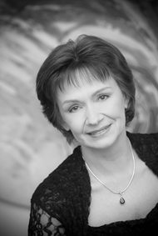
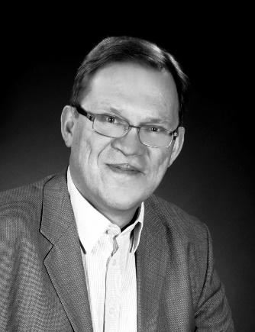
Project Leaders and RTA
Project Leader
Dr Helka Kekäläinen
Head of Higher Education Unit, FINEEC
Junior Project Leader
Dr Heli Mattisen
Director of Estonian Higher Education Quality Agency
Resident Twinning Adviser
Mr Reijo Aholainen

Slide 8
It’s all about people and results!
Ministry of Education of the Republic of Azerbaijan
Mandatory results
Legislative framework
Capacity Building of MoES Staff
Project Steering Committee
PL & JPL MS – PL BC
RTA MS – RTA Counterpart
STE’s and experts in Azerbaijan institutions
The AzQF sections relevant for higher education
Standards and Guidelines for QA in HE in Azerbaijan
HEIs and the European Framework
Other beneficiaries and partners involved in Azerbaijan

Slide 9
Component I
The legal and normative framework for HE is reviewed and concrete recommendations for adapting legislation relevant to QA and the HE sections of the AzQF in Azerbaijan are developed.
Comparative table on the conformity with Bologna framework
Gap assessment
Recommendations

Slide 10
Component II
The coordination & networking capacity of the MoE and relevant stakeholders is enhanced on the basis of good practice examples in the EHEA.
Analysis of institutional setup
Organisation chart
Training needs analysis
Study visit to Brussels
Expert visits to Finland and Estonia
Communication strategy

Slide 11
Component III
The AzQF sections relevant for higher education are developed in line with the EHEA QF in cooperation with HEIs. A roadmap for the full implementation of the framework(s) in higher education is agreed.
Trainings and training materials
Concrete proposal for QF alignment for HE
Road map to development of Doctoral degrees
Proposal for updating recognition procedures and practice

Slide 12
Component IV
Standards and Guidelines for Quality Assurance in HE in Azerbaijan are developed in line with the European Standards and Guidelines for Quality Assurance. 3 institutions have undergone an Internal and external evaluation (pilot).
Training sessions
Study tour to FINEEC and EKKA for QA experts
Proposal for the Standards and Guidelines for QA in Azeri higher education
Blueprint for QA agency statues, organization etc.
Pilot evaluations

Slide 13
Objectives of the Training
What a learner is expected to know, understand and be able to demonstrate after completion of learning?
Understand and recognize Bologna context: process, history, governance
Distinguish internal and external quality assurance
Explain institutional approach to external quality assurance
Apply European Standards and Guidelines (ESG 2015) Part 1
Participants will be on their way to become Future Experts in Quality Assurance in Azerbaijani Higher Education

Slide 14

Thank you for your attention!

