Slide 1


Bologna Process - objectives and achievements
Ms. Sirpa Moitus, FINEEC
Mr. Kauko Hämäläinen
Baku, 29 September 2015

Slide 2
Bologna objectives
Development of a system of easily readable and comparable degrees, designed to increase flexibility and transparency and enable students to have their qualifications recognised more widely. This will be aided by the adoption of a system of credits in the form of the European Credit Transfer System (ECTS) and the Diploma Supplement
Promotion of closer links between the European Higher Education Area (EHEA) and the European Research Area (ERA)
Promotion of mobility of students, academics, researchers and administrative staff within higher education in Europe, and removal of obstacles to students outside of Europe
Promotion of European co-operation in quality assurance; this is key to making the EHEA attractive on the international stage
Promotion of partnership activities and curriculum development between higher education institutions in Europe, and the establishment of Joint Degrees
Commitment to Lifelong Learning
Adoption of a system based on three main cycles within higher education - Bachelors, Masters and Doctoral.

Slide 3
Bologna action lines
Adoption of a system of easily readable and comparable degrees
Adoption of a system essentially based on two cycles[13]
Establishment of a system of credits
Promotion of mobility
Promotion of European co-operation in quality assurance
Promotion of the European dimension in higher education
Focus on lifelong learning
Greater inclusion of higher education institutions and students in the Bologna Process
Promotion of the attractiveness of the European Higher Education Area
Doctoral studies and the synergy between the European Higher Education Area and the European Research Area

Slide 4
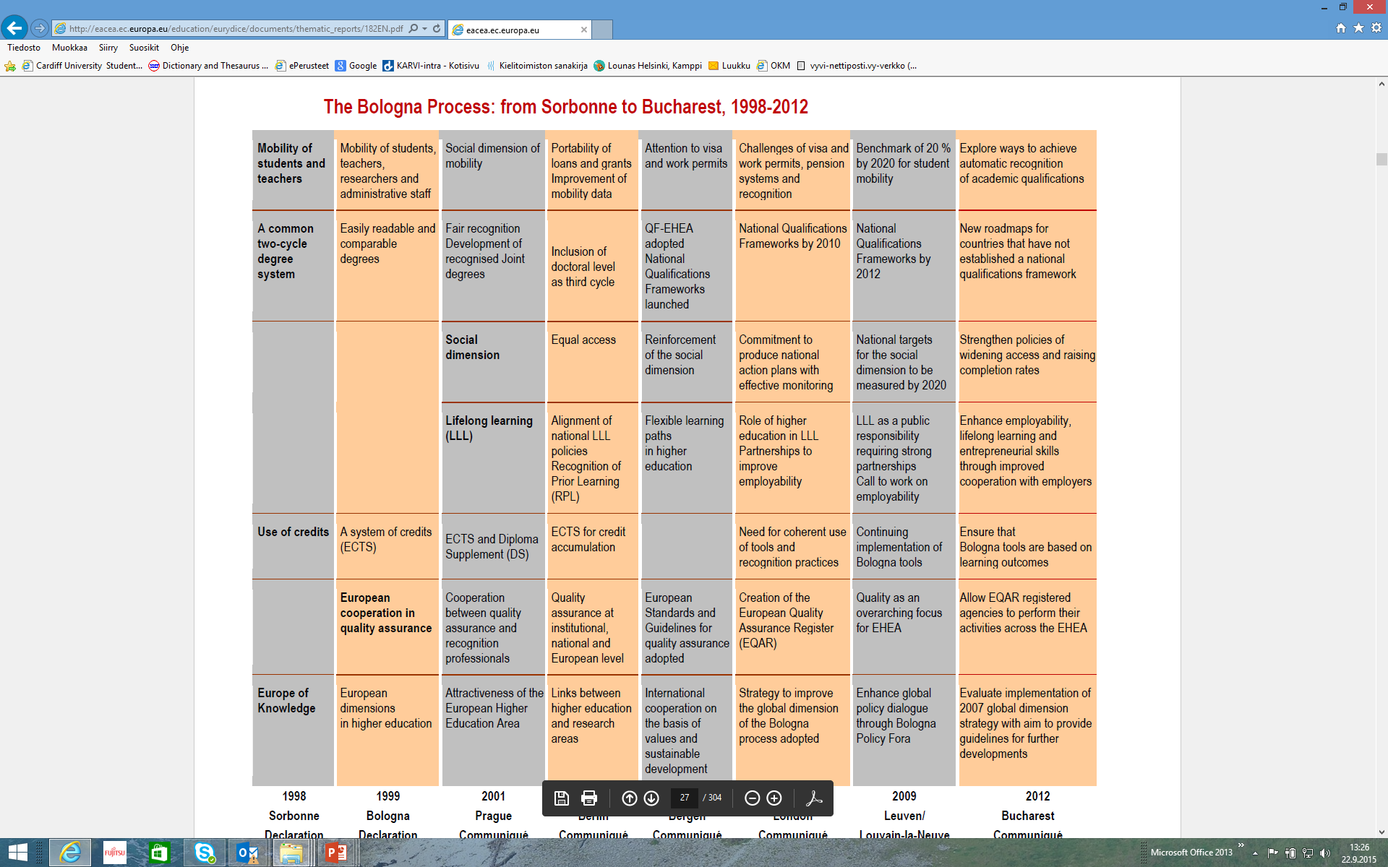
European Commission/EACEA/Eurydice, 2015. The European Higher Education Area in 2015: Bologna Process Implementation Report. Luxembourg: Publications Office of the European Union. (p. 25)

Slide 5
Bologna Process and Quality Assurance

Slide 6
European Standards and Guidelines (ESG)
Prepared by E4 Group: all key stakeholders in European QA and adopted in 2005 by 46 countries
Provide a framework for good practice shared in the whole EHEA to guarantee quality of
Educational activities of HEIs (part 1 – IQA within HEIs)
Organisation of agencies’ work and activities (part 2 – EQA of HE)
External evaluation of agencies (part 3 – operation of QA agencies, almost identical to ENQA membership criteria)
3 interlinked parts
Follow the format of a standard, followed by guidelines → interpretation
Introduced a peer review system for QA agencies.
Operations of the agency ESG Pt 3
External QA processes that agency operates on HEIs
ESG Pt 2
Internal QA processes operating within HEIs
ESG Pt 1

Slide 7
ESG: purposes
They set a common framework for quality assurance systems for learning and teaching at European, national and institutional level;
They enable the assurance and improvement of quality of higher education in the European higher education area;
They support mutual trust, thus facilitating recognition and mobility within and across national borders;
They provide information on quality assurance in the EHEA.

Slide 8
Main principles and values of the ESG
Twin-purpose of QA: ccountability and enhancement
Transparency and external expertise in QA processes
Encourage culture of quality within HEIs
Efficient & effective organisational structures for provision and support of programmes
HEIs have primary responsibility for quality and QA
Processes to demonstrate accountability
Diversity and innovation
Interests of society safeguarded

Slide 9
Expectations for HEIs
It is up to each institution to develop its own quality culture and to put in place policies, strategies and systems adapted to its situation, mission, context and ambition.
The HEIs’ quality assurance mechanisms have to satisfy their proper needs but also the expectations of their partners and stakeholders. The first set of standards clarifies the goals.
Internal evaluation is the corner stone of QA in HE.

Slide 10
Expectations towards policy makers in EHEA
Governments need to look into why (if) they do not have an ESG compliant quality assurance agency at the moment, and what would be required to establish one.
Every country should strive towards the establishment of an independent quality assurance agency, and to make sure that each agency’s operations (including those already existing) are in line with the ESG.
The revised ESG may impose legal changes in some countries, and therefore their effective implementation depends not only on the quality assurance agencies and higher education institutions, but also on the policy makers (→ This could for example concern the publication of review reports, which is currently not possible in some countries - i.e. reports with negative review outcomes are not being published).

Slide 11
Expectations for agencies
In order to be recognised as trustworthy ,need to prove that fulfil the requirements of the ESG for external quality assurance agencies (ESG Part 3)
External evaluation is a condition of the credibility of the results of the internal evaluation
External evaluators (QA agencies) are accountable for the quality of their activities
Use procedures that comply with the ESG for the external quality assurance of higher education (ESG Part 2)
Verify the HEIs’ achievements against the ESG for internal quality assurance (ESG Part 1)

Slide 12
Bologna Process and Qualifications Frameworks

Slide 13
Role of Qualifications Frameworks
European perspective: Qualifications frameworks
EQF for Higher Education
(Bologna Process -
48 countries)
EQF for Lifelong Learning (an EC initiative)
(27 countries)
Dublin descriptors
National Qualifications Frameworks
Sectoral Qualifications Frameworks
TUNING reference points for Higher Education programmes

Slide 14
EQF Lifelong learning
Adopted 2008
27 countries
All levels of education in a lifelong learning perspective
8 levels
Without any credit ranges
Three categories:
Knowledge
Skills
Competences (social competences, abilities)
Bologna (QF-EHEA)
Adopted 2005
48 countries
Higher education only, 3 cycles
Level 6, 180-240 ECTS
Level 7, 60 – 120 ECTS
Level 8, ????
(with possibility for intermediate qualifications in national frameworks – level 5)
ECTS: 60 credits/year, 1 Credit 25-30 h of student workload

Slide 15
Language of the Qualifications frameworks: Learning outcomes – widely understood
Statements of what a learner is expected to know, understand and be able to demonstrate after completion of learning.
HE: They are expressed in curricula, modules, course descriptions, educational standards, qualifications and assessment standards. Learning outcomes specify the requirements for award of credit.
Work context: Occupational standards and profiles, job profiles, job advertisements, performance and recruiting systems
Personal context: curriculum vitae or personal competence profiles
[HE learning outcomes are to be formulated by academic staff]

