Slide 1





Kick Off Meeting
Support to the Ministry of Education of the Republic of Azerbaijan for further adherence of the higher education system to the European Higher Education Area (AZ-ad-EHEA)
This project is funded by
the European Union
aZERBAIJAN, Finland, ESTONIA
18 November 2015

Slide 2
FINEEC – Finnish Education Evaluation Centre
To evaluate activities of education and training providers and higher education institutions
To support education and training providers and HEIs
To develop evaluation of education

Slide 3
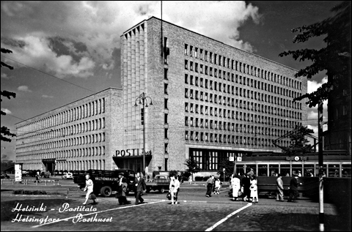
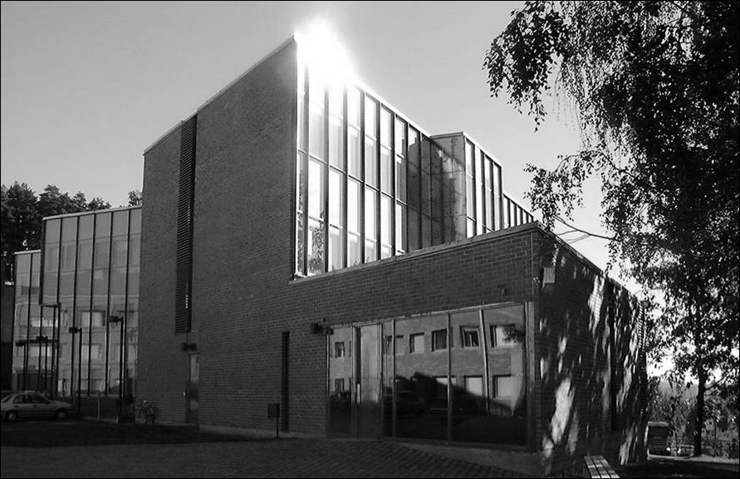
Operating in Helsinki and Jyväskylä
Total approx. 40 persons
Image: Gustav Welin, Museum of Finnish Architecture
Image: University of Jyväskylä

Slide 4
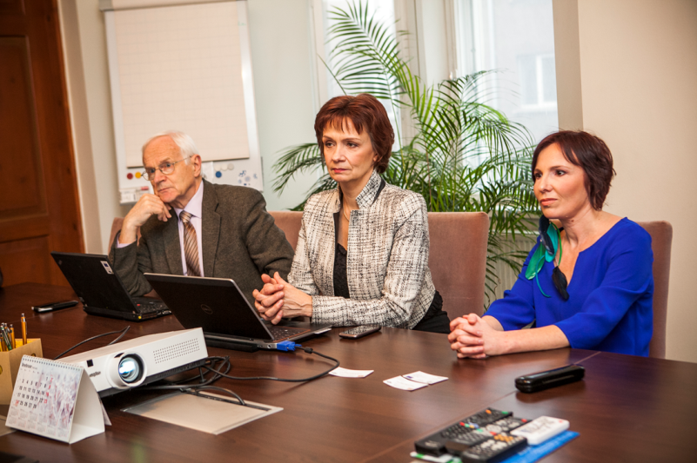

EKKA
Full member of ENQA and EQAR
EKKA’s mission is,
in cooperation with its partners,
to promote quality in the field of education
and thereby increase the competitiveness
of the Estonian society.

Slide 5
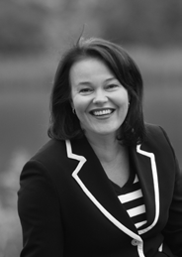
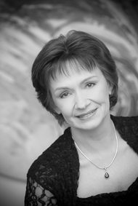
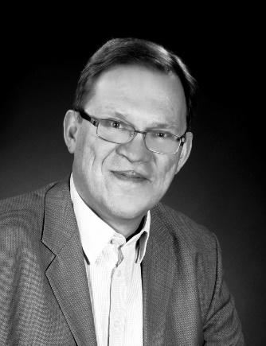
Project Leaders and RTA
Project Leader
Dr Helka Kekäläinen
Head of Higher Education Unit, FINEEC
Junior Project Leader
Dr Heli Mattisen
Director of Estonian Higher Education Quality Agency
Resident Twinning Adviser
Mr Reijo Aholainen

Slide 6
Institutions and Experts committed to the project
There are altogether n Short Term Experts committed to the project:
  Finnish Education Evaluation Centre FINEEC
  Estonian Higher Education Quality Agency EKKA, Foundation Archimedes
  The Ministry of Education and Culture of Finland
  The Ministry of Education and Research of Estonia
  CIMO Centre for International Mobility, Finland
  Estonian Qualifications Authority EQA
  Finnish Universities and Universities of Applied Sciences
  Individual Experts from ENQA and EUA.
Academic perspective is entailed by university researchers and teachers. The two Finnish national student unions are involved in the project. Legal counsellors are also included in the team of experts.

Slide 7
It’s all about people and results!
Ministry of Education of the Republic of Azerbaijan
Mandatory results
Legislative framework
Capacity Building of MoES Staff
Project Steering Committee
PL & JPL MS – PL BC
RTA MS – RTA Counterpart
STE’s and experts in Azerbaijan institutions
The AzQF sections relevant for higher education
Standards and Guidelines for QA in HE in Azerbaijan
HEIs and the European Framework
Other beneficiaries and partners involved in Azerbaijan

Slide 8
Component I
The legal and normative framework for HE is reviewed and concrete recommendations for adapting legislation relevant to QA and the HE sections of the AzQF in Azerbaijan are developed.
Comparative table on the conformity with Bologna framework
Gap assessment
Recommendations

Slide 9
Component II
The coordination & networking capacity of the MoE and relevant stakeholders is enhanced on the basis of good practice examples in the EHEA.
Analysis of institutional setup
Organisation chart
Training needs analysis
Study visit to Brussels
Expert visits to Finland and Estonia
Communication strategy

Slide 10
Component III
The AzQF sections relevant for higher education are developed in line with the EHEA QF in cooperation with HEIs. A roadmap for the full implementation of the framework(s) in higher education is agreed.
Trainings and training materials
Concrete proposal for QF alignment for HE
Road map to development of Doctoral degrees
Proposal for updating recognition procedures and practice

Slide 11
Component IV
Standards and Guidelines for Quality Assurance in HE in Azerbaijan are developed in line with the European Standards and Guidelines for Quality Assurance. 3 institutions have undergone an Internal and external evaluation (pilot).
Training sessions
Study tour to FINEEC and EKKA for QA experts
Proposal for the Standards and Guidelines for QA in Azeri higher education
Blueprint for QA agency statues, organization etc.
Pilot evaluations

Slide 12
Advantages of working with
Finland and Estonia
Finland – leading EU country in the area of education, global leader of the development of learning culture throughout the society
Estonia – success-story among the post-socialist countries –high ranking in PISA, effiecient implementation of Bologna principles
The success in the area of education is linked with economical success: Finland among top-five countries in the global ranking, Estonia the first among post-socialist countries
Estonia’s advantages in supporting educational developments in post-socialist countries in the area of education, having shared the common history
Long and fruitful history of cooperation between Finland and Estonia, as well as between Estonia and Azerbaijan
Finland and Estonia – countries learning from best practices from all around the world and shareing their experience in international networks
Tolerance and mutual understanding as underlaying values of the cooperation

Slide 13
Finland Leading the Development of Learning Culture
CRITICAL
SUCCESS FACTORS
Excellent expertise
Motivating leadership
Committed personnel
Effective guidance
VISION
Broad-based
education and
excellence guarantee
a sustainable
future, well-being
and economic
competitiveness.
Life-long learning culture
POLICY
Knowledge-based
approach
Global perspective
Networking
Future orientation
Competence development
Creativity
Esteem
VALUES
Equity
Fairness
Openness
Trust

Slide 14
Estonian LLL strategy 2020
Learning is a lifestyle.
Let’s notice development opportunities and let’s look for clever solutions.
Responsibility – People understand that learning and self-development are their own choice and responsibility
Needs – Studies are based on the learner’s interests and capabilities, they support his or her development and meet actual labour market needs
Opportunities – The lifelong learning system offers good quality, modern, flexible study opportunities that also take the learners’ special needs into account

Slide 15

Let’s do it together!

