Slide 1








Support to the Ministry of Education of the Republic of Azerbaijan for Further Adherence of the Higher Education System to the European Higher Education Area
(AZ-ad-EHEA)
Reijo Aholainen, RTA Resident Twinning Adviser
This project is funded by the European Union

Slide 2
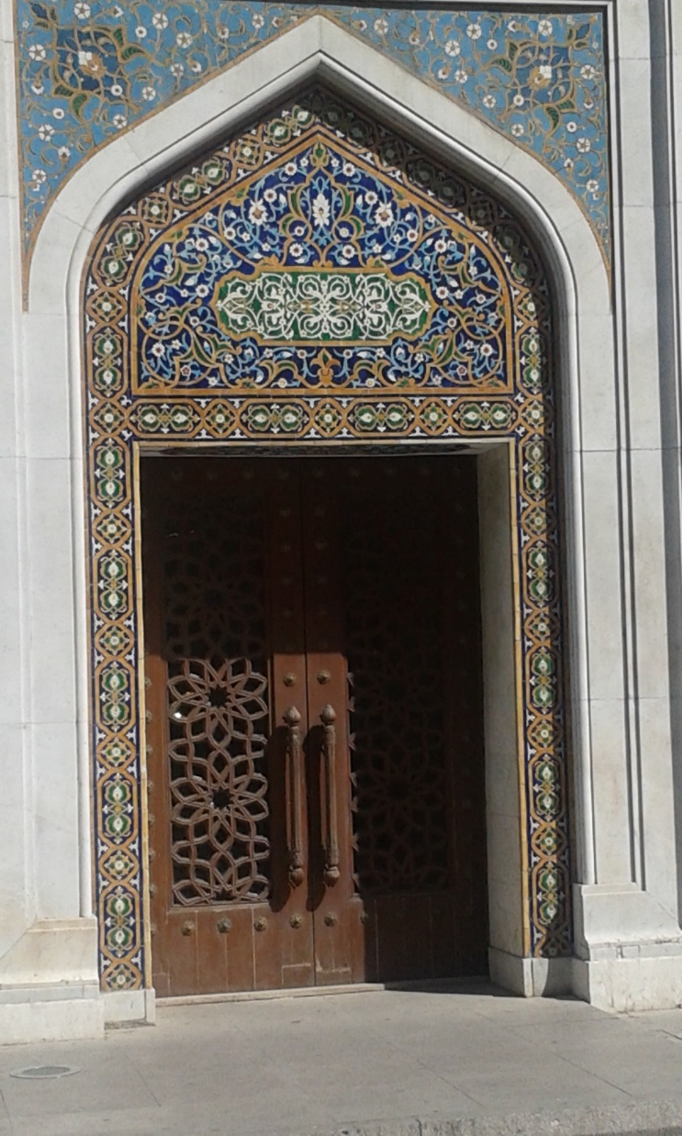
The Purpose
Increase institutional capacities of the Ministry of Education and other key institutions
  Development of Azerbaijan higher education policies related to the EHEA
  Implementation of the EHEA objectives and reference tools in Azerbaijan

Slide 3

Project Objective
Further development of Azerbaijan’s higher education system
  increased integration in the European Higher Education Area (EHEA)
This project is funded by the European Union

Slide 4
Mandatory Results
Legislative framework
Capacity Building of MoE Staff
The AzQF sections relevant for higher education
Standards and Guidelines for QA in HE in Azerbaijan

Slide 5
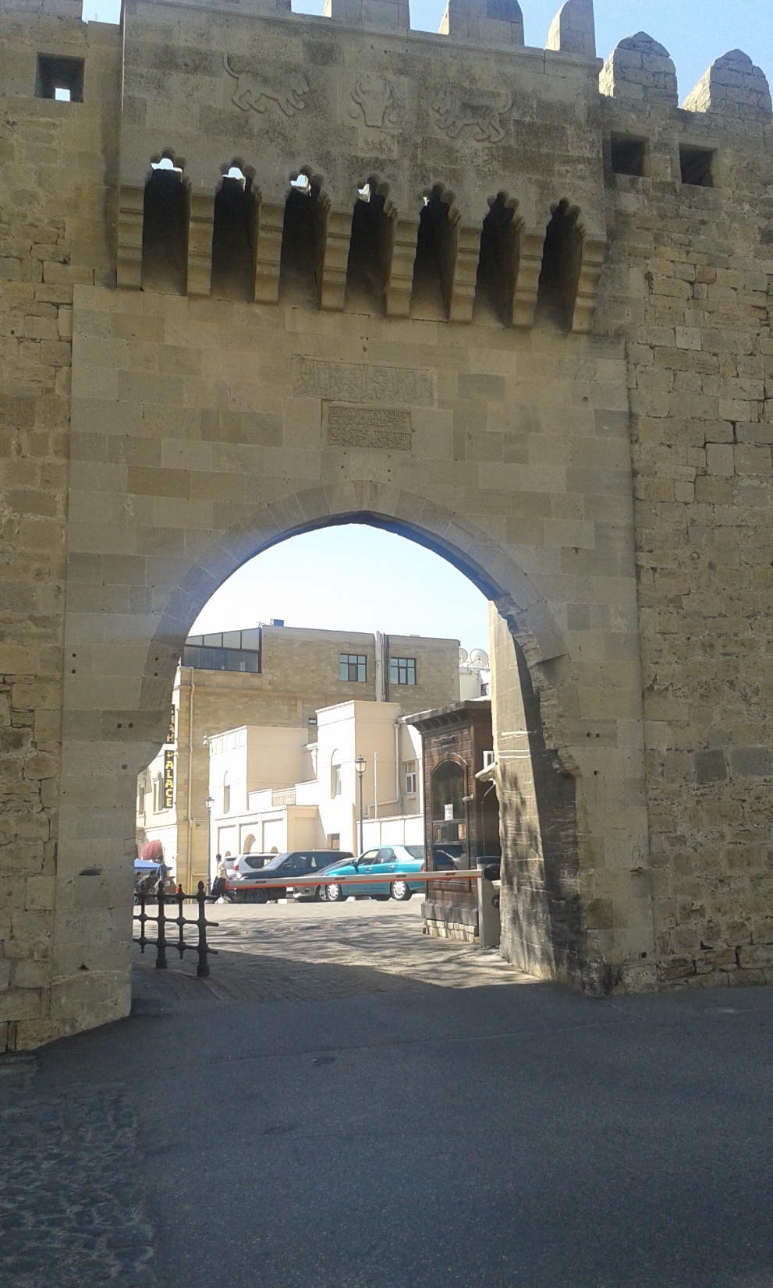
Mandatory Result 4:
Standards for Quality Assurance in HE
Development of Azerbaijan Higher Education Standards and Guidelines for Quality Assurance in line with the European Standards and Guidelines
Pilot evaluation in three HEIs

Slide 6
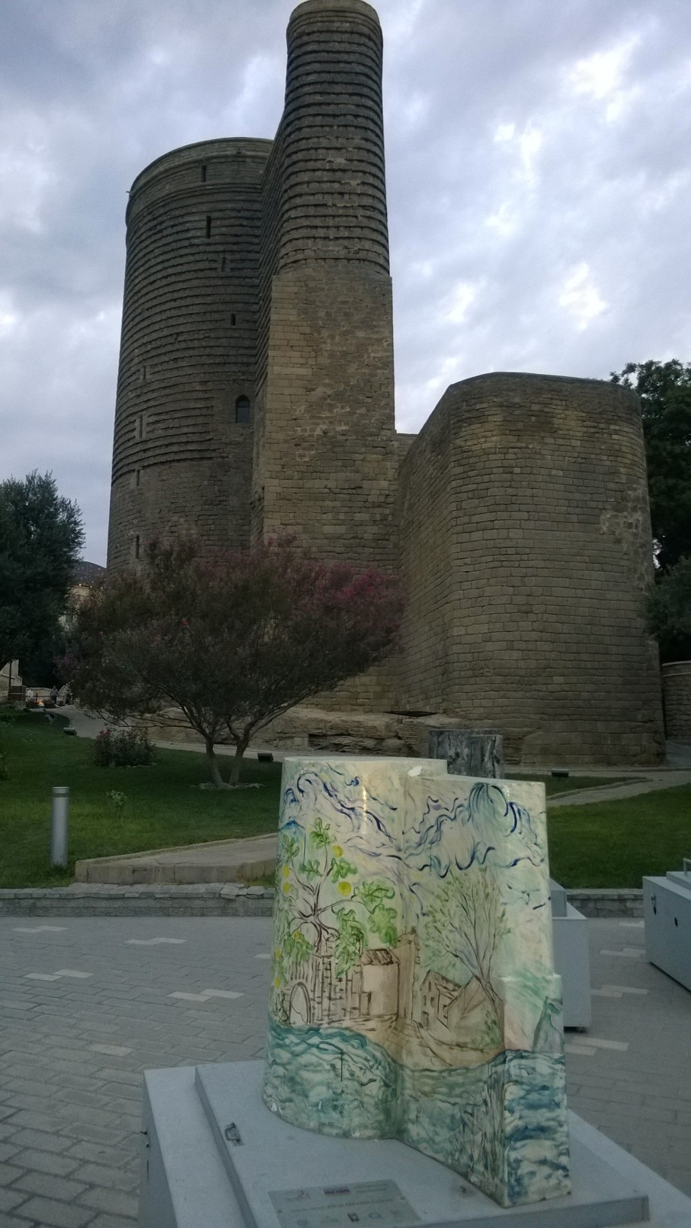
Mandatory Result No 3:
Development of the Azerbaijan QF
Development of AzQF sections relevant for higher education are developed in line with the EHEA QF in cooperation with HEIs.
A roadmap for the full implementation of the AzQF in higher education

Slide 7
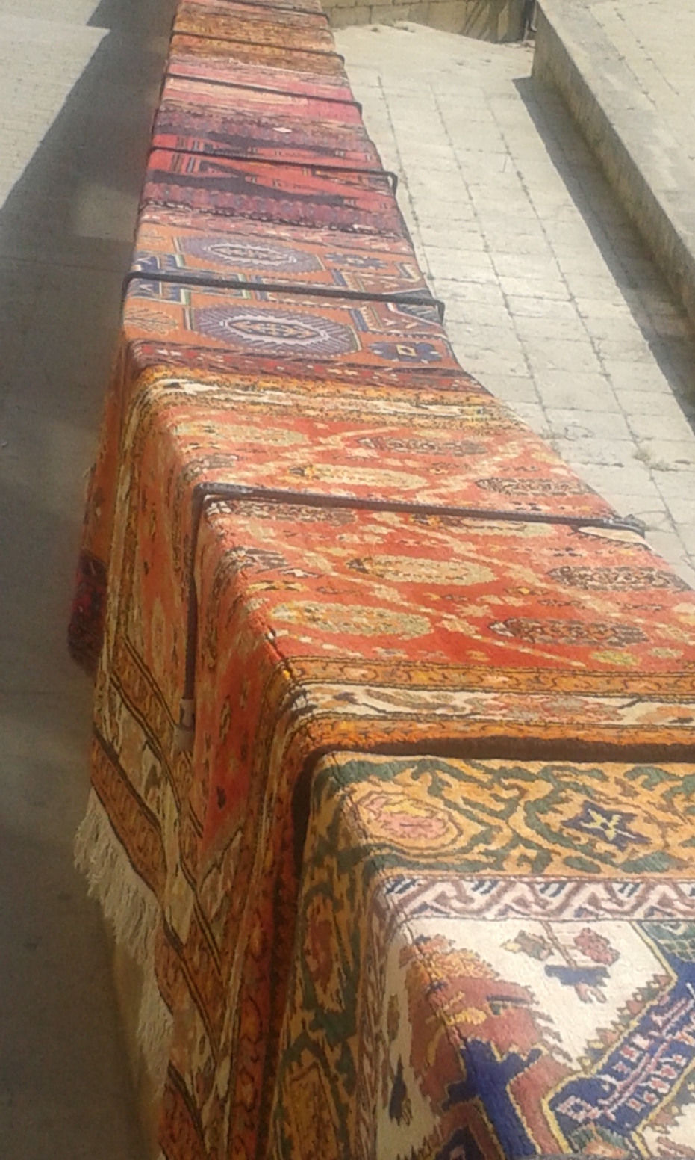
Mandatory Result 2:
Coordination and Networking Capacity
Enhancing the coordination and networking capacity of the Ministry and stakeholders
Improve institutional architecture

Slide 8
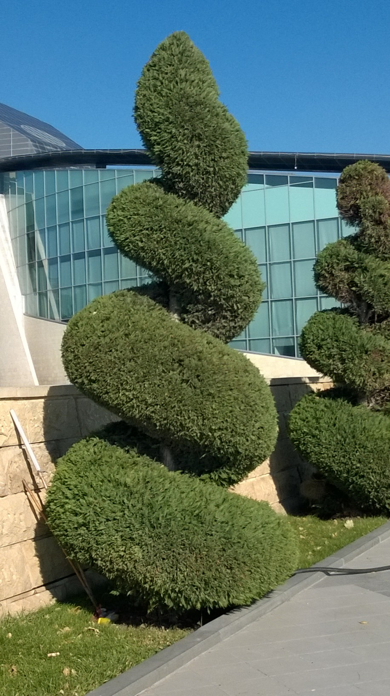
Mandatory Result 1:
Legal Framework
Review of Azerbaijan relent Higher Education legislation
Concrete recommendations for adapting legislation relevant to Quality Assurance and Azerbaijan Qualification Framework relevant to Higher Education

Slide 9
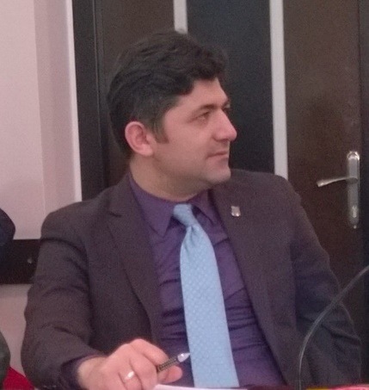
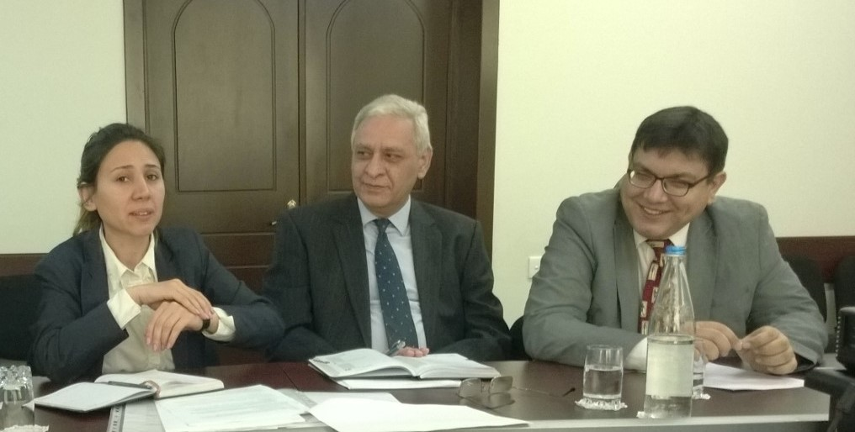
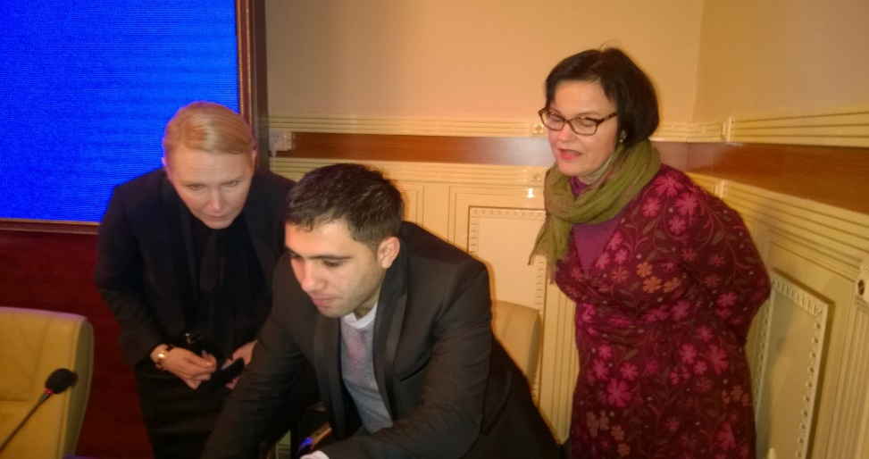

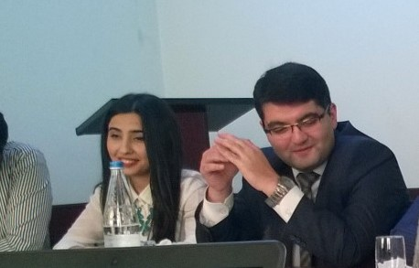
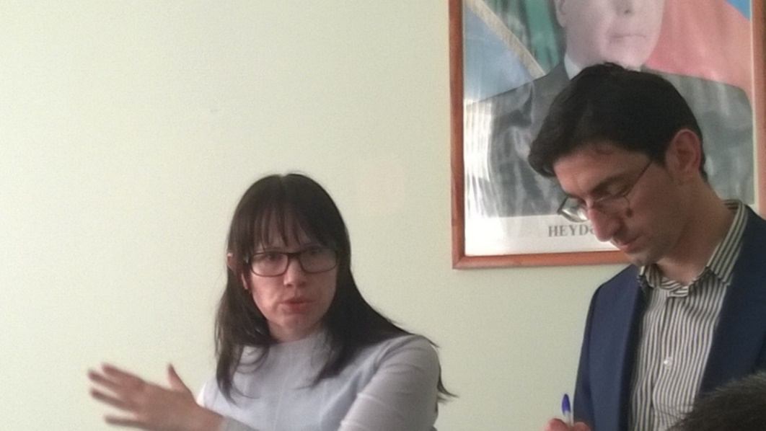
EHEA Twinning Project Resources:
EU Funding 1.3 M€ - 470 STE Days

Slide 10

Let’s do it together!
It’s about people and results!

