Slide 1
EUR-ACE Engineering Programme Accreditations

Slide 2
Topics
EUR-ACE Standard
FINEEC’s Engineering Programme Accreditations
Process
Accreditation standards
Reference programme outcomes

Slide 3
EUR-ACE

Slide 4
Background
European Network for Accreditation of Engineering Education ENAEE was founded in 2006 to help
a) building confidence in systems of accreditation of engineering degree programmes within Europe
b) facilitating exchange of information
c) developing voluntary agreements on accreditation of engineering educational programmes and recognition of engineering qualifications and
d) the development of standards for competency requirements of graduate engineers.
Most of the founding members had already a long experience in engineering accreditation
Target: build a system with peer recognition & common reference standards, compliant with the ESG

Slide 5
EUR-ACE Model
To address these needs, ENAEE created the EUR-ACE (European Accredited Engineer) Model for Accreditation of Engineering Programmes
EUR-ACE standards and guidelines are described in terms of
the student workload requirements;
reference programme outcomes for engineering degree programmes; and
programme management
An accreditation confirms that a programme operates according to the standards; so that the programme outcomes are achieved
ENAEE gives the license to award the EUR-ACE label to national accreditation agencies, ENAEE does not conduct accreditations by itself

Slide 6
EUR-ACE in 2016
Renewed standard
13 quality assurance agencies are authorised to award the EUR-ACE Label
Around 2100 accredited programmes (of which 650 in Germany, 400 in France, 250 in Turkey, 200 in UK, 150 in Russia)
Mutual recognition of EUR-ACE accreditations by the accreditation agencies

Slide 7
FINEEC’s Engineering Programme Accreditations

Slide 8
Engineering Programme Accreditation
FINEEC’s own interpretation of the EUR-ACE standard
Voluntary for the institutions, offered as paid services
New process for FINEEC
FINEEC was authorised to award the EUR-ACE label to 4 year Bacherlor’s degrees in summer 2014, following an external evaluation by ENAEE
3 completed accreditations, 1 on-going

Slide 9
Aims
To support the development of quality in engineering degree programmes
To increase international comparability and recognition of Finnish engineering degrees
=> and in a more concrete level: to evaluate if an engineering programme fulfils the accreditation standards

Slide 10
Accreditation standards

Slide 11
Accreditation standards
To be accredited, the engineering programme has to fulfill the FINEEC accreditation standards
The standards are divided into four categories
Planning of the programme
Implementation of teaching and learning
Resources
Quality management

Slide 12
Evidence
The self-assessment report of the programme describes how the programme itself feels it fulfils the standards
The evidence room in the site visit includes exam papers, project works, thesis’ etc and complements the self-assessment report
The accreditation team has access to relevant IT systems, such as curriculum planning system, online teaching platforms and intranet.
The interviews during the site visit confirm, complement and extend the self-assessment

Slide 13
Planning of the programme
The programme aims, which describe the educational task and purpose of the programme, are consistent with the mission of the higher education institution and reflect the identified needs of employers and other stakeholders.
The programme learning outcomes, which describe the knowledge, understanding, skills and abilities that the programme enables graduates to demonstrate, are consistent with the programme aims, with relevant national qualifications frameworks (if applicable) and with the FINEEC reference programme learning outcomes.
The course level learning outcomes, including thesis work and possible practical training, aggregate to the programme’s learning outcomes.
The curriculum gives comprehensive information on all the individual courses of the programme, including thesis work and possible practical training, and is accessible to students.
The curriculum and the course timetable enable students to graduate in the expected time.
The criteria and process for student admission and transfer are clearly specified and published. Students should be informed of the qualifications necessary to enter the programme.
Students are informed of regulations and guidelines that concern recognition of prior learning, progress of studies and graduation.

Slide 14
Implementation of teaching and learning
The teaching and learning process, including the assessment of students, enables students to demonstrate that they have achieved the intended course and programme level learning outcomes.
Students have an active role in co-creating the learning process and the assessment of students reflects this approach.

Slide 15
Resources
The academic staff are sufficient in number and qualification to enable students to achieve the programme learning outcomes. There are arrangements in place to keep the pedagogical and professional competence of the academic staff up to date.
An effective team of technical and administrative staff supports the programme. There are arrangements in place to keep the competence of the support staff up to date.
The students are provided adequate and accessible support services to enable the achievement of the programme learning outcomes.
The classrooms, computing facilities, software, laboratories, workshops, libraries and associated equipment and services are sufficient and accessible to enable students to achieve the programme learning outcomes.
The HEI and the programme have external partnerships that are adequate to the achievement of the programme learning outcomes.
The financial resources are sufficient to implement the learning process as planned and to further develop it.

Slide 16
Quality management
The quality management procedures of the programme are consistent with the quality policy of the higher education institution.
The organisation and decision-making processes of the programme are fit for effective management.
The programme reviews and develops the programme aims, curriculum, teaching and learning process, resources and partnerships and quality management in a systematic and regular manner, taking into account analysis of results of student admissions, students’ study progress, achieved learning levels, student, graduate and employer feedback and graduate’s employment data.
The programme provides public, up to date information about its objectives, teaching and learning process, resources, quality management procedures and results.

Slide 17
Reference programme outcomes

Slide 18
Reference programme learning outcomes
A general level description of the learning outcomes that a graduate from an engineering programme should be able to demonstrate
The accreditation team applies them in the context of the programme’s branch of engineering
The programme to be accredited has its own programme learning outcomes
The self-assessment report explains how the programme’s learning outcomes cover the reference programme learning outcomes
The self-evaluation report includes a curriculum analysis, which shows how the curriculum connects to the programme learning outcomes

Slide 19
Requirements for the programme learning outcomes
The programme learning outcomes should be consistent with
the programme aims
relevant national qualifications frameworks (if applicable) and
with the FINEEC reference programme learning outcomes
The course level learning outcomes aggregate to the programme’s learning outcomes
The teaching and learning process, including the assessment of students, enables students to demonstrate that they have achieved the intended course and programme learning outcomes.

Slide 20
Reference programme learning outcome topics
Knowledge and understanding
Engineering practice
Investigations and information retrieval
Multidisciplinary competences
Communication and team-working

Slide 21
Knowledge and understanding on Bachelor’s level
The learning process should enable graduates to demonstrate:
knowledge and understanding of mathematics and other basic sciences underlying their engineering specialisation, at a level necessary to achieve the other programme learning outcomes;
knowledge and understanding of engineering disciplines underlying their specialisation, at a level necessary to achieve the other programme learning outcomes, including some awareness at the forefront;
knowledge and understanding of applicable materials, equipment and tools, engineering technologies and processes, and of their limitations, in their specialisation
knowledge and understanding of applicable techniques and methods of analysis, design and investigation, and of their limitations, in their specialisation;

Slide 22
Engineering practice on Bachelor’s level
ability to analyse complex engineering products, processes and systems, and to correctly interpret the outcomes of such analyses, by being able to select and having the practical skills to apply relevant established analytical, computational and experimental techniques and methods
ability to identify, formulate and solve complex engineering problems, by being able to select and having the practical skills to apply relevant established analytical, computational and experimental techniques and methods
ability to develop and design complex products (devices, artefacts, etc.), processes and systems to meet established requirements that can include societal, health and safety, environmental, economic and industrial constraints, by being able to select and having the practical skills to apply relevant design methodologies
practical skills for realising complex engineering designs
ability to use the awareness of the forefront of their engineering specialisation in design and development
ability to apply norms of engineering practice in their engineering specialisation;
ability to consult and apply codes of practice and safety regulations in their engineering specialisation

Slide 23
Investigations and information retrieval on Bachelor’s level
The learning process should enable Bachelor Degree graduates to demonstrate:
ability to conduct searches of literature, to consult and to critically use scientific databases and other appropriate sources of information, and to carry out simulation and analysis, in order to pursue detailed investigations and research of technical issues
ability and practical skills to design and conduct experimental investigations, interpret data and draw conclusions
ability to work in a laboratory/workshop setting

Slide 24
Multidisciplinary competences on Bachelor’s level
awareness of the wider multidisciplinary context of engineering
awareness of societal, health and safety, environmental, economic and industrial implications of engineering practice and recognition of the constraints that they pose
awareness of economic, organisational and managerial issues (such as project management, risk and change management) in the industrial and business context
ability to gather and interpret relevant data and handle complexity to inform judgements that include reflection on relevant social and ethical issues;
ability to manage complex technical or professional activities or projects, taking responsibility for decision making
ability to recognise the need for and to engage in independent life-long learning
ability to follow developments in science and technology

Slide 25
Communication and team-working on Bachelor’s level
The learning process should enable Bachelor Degree graduates to demonstrate:
ability to communicate effectively information, ideas, problems and solutions with the engineering community
ability to communicate effectively information, ideas, problems and solutions with the society at large;
ability to function effectively in a national and an international context;
ability to function effectively as an individual and as a member of a team;
ability to cooperate effectively with engineers and non-engineers.

Slide 26
The process

Slide 27
Preparations
A contract is made between FINEEC and the institution
FINEEC appoints the review team
The review team is trained
The institution prepares the self-evaluation report
According to FINEEC template
The review team prepares for the site-visit to the institution
studies the self-evaluation report
writes initial observations before the visit
prepares questions and topics for the interview sessions

Slide 28
The site-visit
A two-day site-visit is conducted
Interviews of the programme management, teaching staff, support staff, students, alumni and external stakeholders (especially employers)
Study of evidence: course material, assessed course work, thesis work, project works, etc.
Tour of facilities: laboratories, library, computer classes…

Slide 29
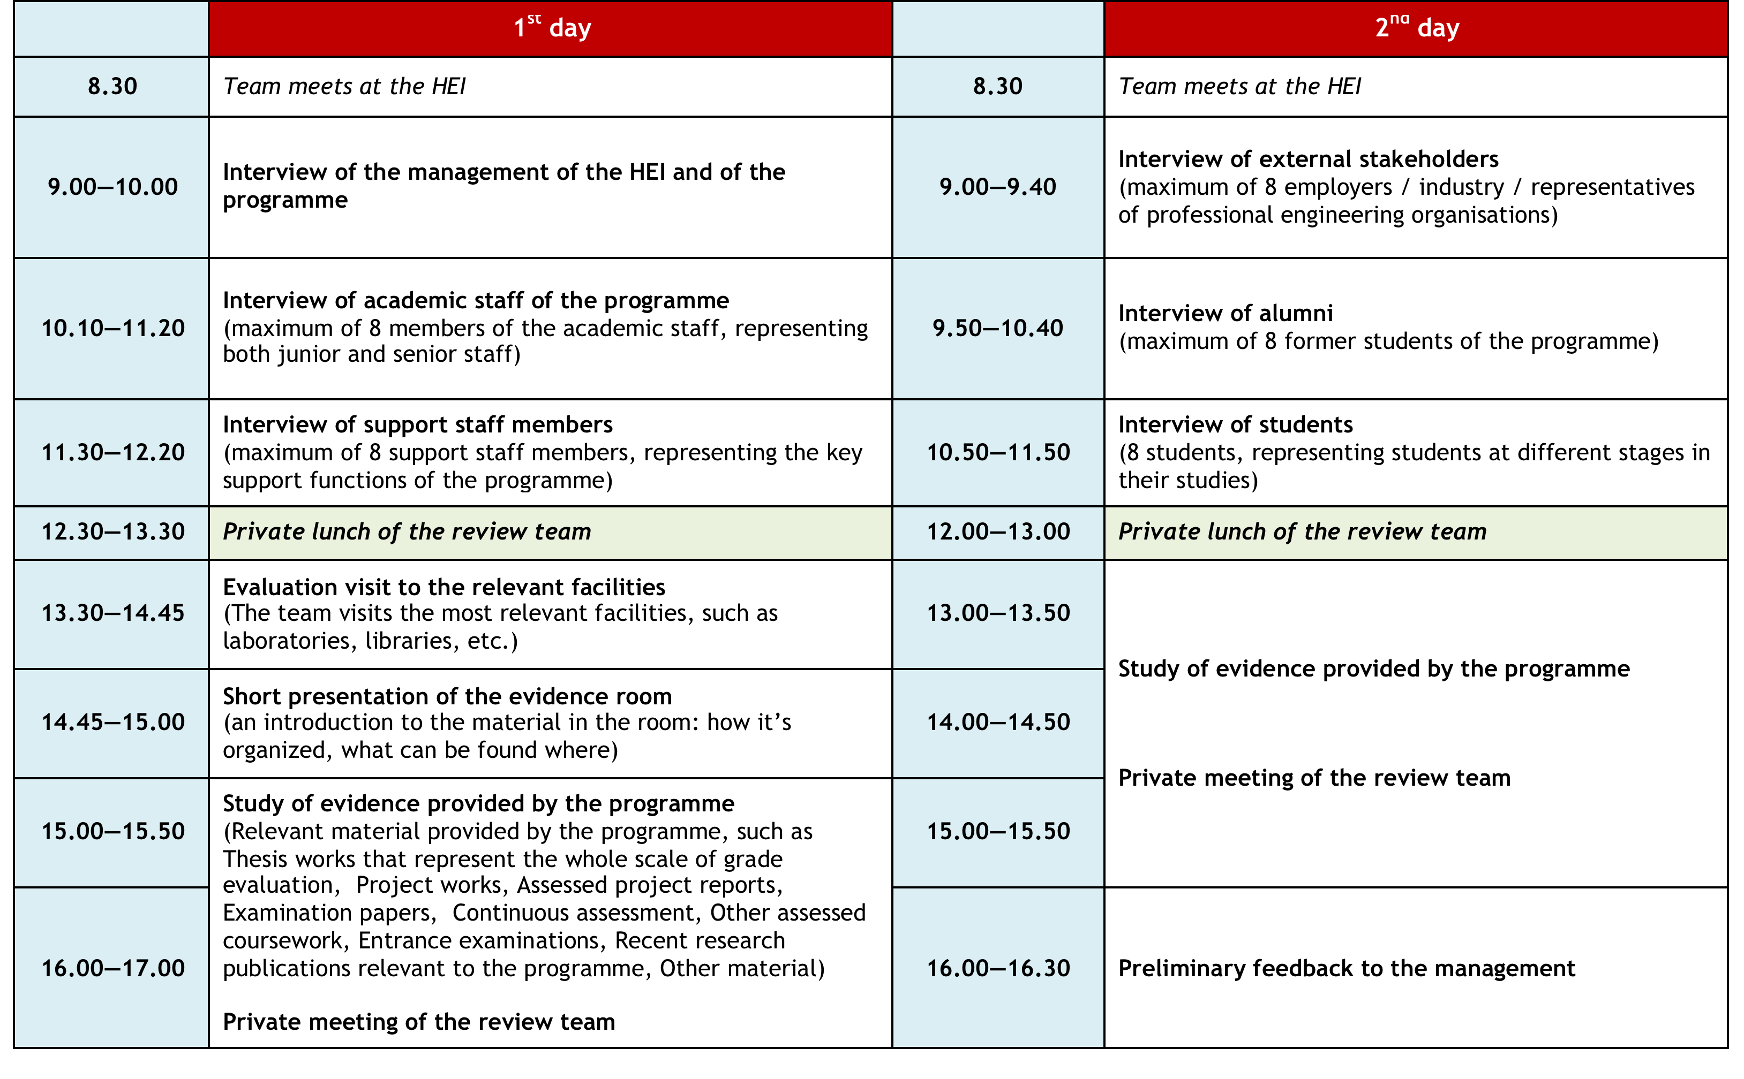

Slide 30
Report
The team prepares the review report
Assessment of each individual standard and of the programme as a whole
All standards must be fulfilled or conditionally fulfilled in order to be accredited or conditionally accredited
University checks for factual errors before decision-making

Slide 31
Decision making
FINEEC Committee for Engineering Education decides on the accreditation
Decision is based on the accreditation team’s report
The Chair of the accreditation team presents the team’s results
Three possible outcomes
Programme is accredited
EUR-ACE label for 6 years
Programme is conditionally accredited
EUR-ACE label conditionally until the conditions are met, then for 6 years from the original decision
Programme is not accredited
The report is published online
In the case of a positive result, FINEEC adds the programme to the EUR-ACE database

Slide 32
After the accreditation
FINEEC collects feedback
From the accreditation team members
From the institution
FINEEC Committee for Engineering Education is responsible for developing the accreditation model
The programme must be accredited again before the validity expires, if it wishes to keep the EUR-ACE Label

