Slide 1
Finnish
Education
Evaluation
Centre
Director Harri Peltoniemi
3 June 2016

Slide 2

Azerbaijan Twinning Project Study Visit
Welcome!
Director Harri Peltoniemi
3 June 2016

Slide 3
FINEEC
Independent expert organisation
1st of May 2014 →
Responsible for external evaluation at all levels of education in Finland

Slide 4

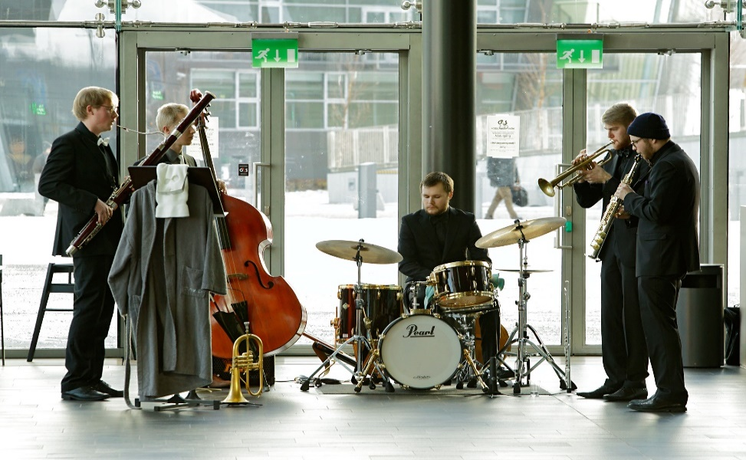
From early childhood to higher education
Early childhood and pre-primary
Primary
Secondary
Vocational
Basic education in arts
Liberal adult education
Adult education
Higher education

Slide 5
Finnish education system
Licentiate & PhD
Master’s
Master’s
Work experience
Bachelor’s
Bachelor’s
Universities
Universities of Applied Sciences
Specialist vocational qualification
General upper secondary
education
Vocational upper secondary education and training
Work
experience
Further
vocational qualification
10th
Age
7 - 15
Basic education
9 years
Work experience
Age 6
Age 0 - 6
Preprimary education
Early childhood education and care
Notes:
lisää ecec –kohtaan vasemmalle AGE

Slide 6
FINEEC’s organisation

Slide 7
FINEEC
Evaluation Council
Director
HE Evaluation Committee
Management team
Higher Education
Primary and secondary education
Vocational education
Evaluations
Support to education providers and HEIs
Development of methodology
Common services

Slide 8
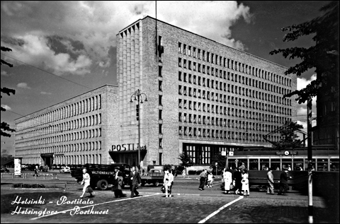
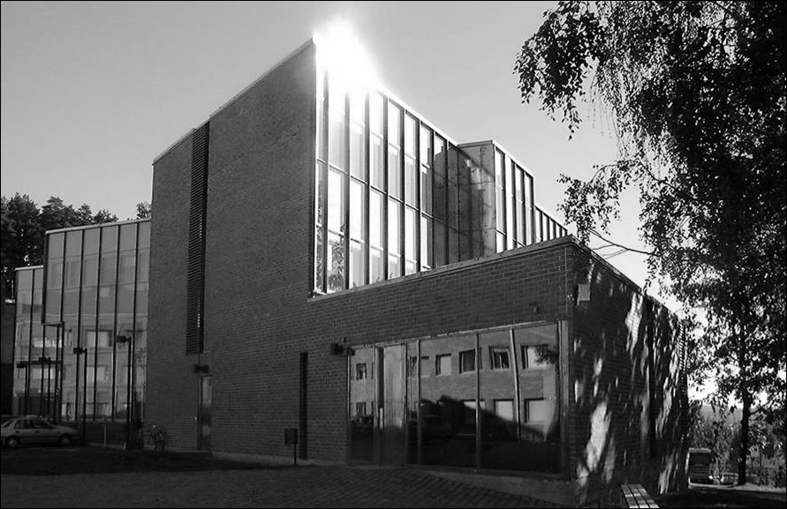
Operating in Helsinki and Jyväskylä
Personnel: approximately 50
Image: Gustav Welin, Museum of Finnish Architecture
Image: University of Jyväskylä

Slide 9
Operating principles
Decision-making is independent of external influence
Follows the principle of enhancement-led evaluation
Actively disseminates the results of evaluations

Slide 10
The tasks of FINEEC
To evaluate activities of education providers and higher education institutions
To undertake evaluations of learning outcomes
To audit quality systems
To conduct thematic evaluations and evaluations of educational fields
To support education providers and higher education institutions
To develop the evaluation of education

Slide 11
Evaluation Council
13 members
Appointed by the Government
Four-year terms (current: 2014-2018)
Supervises and develops FINEEC’s activities
Participates in strategic planning
Prepares statements on long-term issues
Prepares the Educational Evaluation Plan
Approves evaluation project plans

Slide 12
Higher Education Evaluation Committee
9 members (of whom 3 are also members of the Evaluation Council)
Four-year terms (current: 2014-2018)
Appointed by the Ministry of Education and Culture
Makes decisions on:
  Evaluation project plans
  The composition of planning and evaluation teams
  Approval of the final results

Slide 13
FINEEC’s strategy:
Foresight and effective evaluation 2020

Slide 14
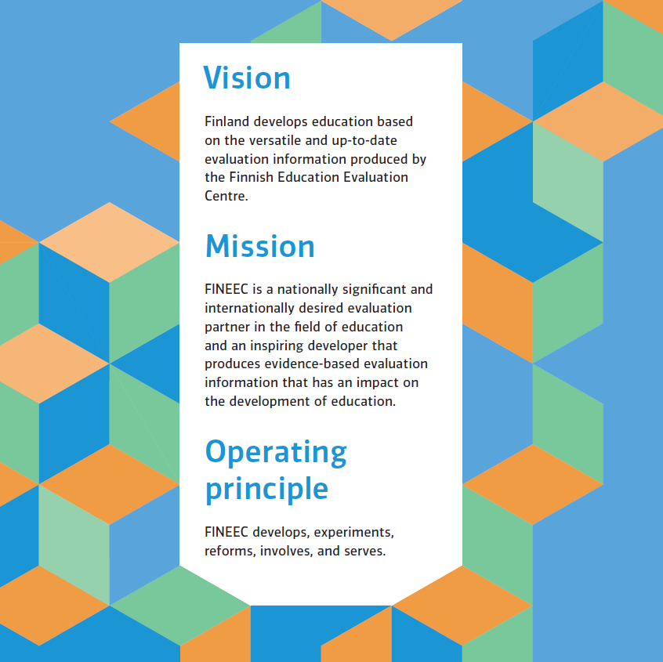

Slide 15
The strategic goals of FINEEC
Impact
Efficiency
Competence of personnel
Development
Reputation
Accuracy

Slide 16
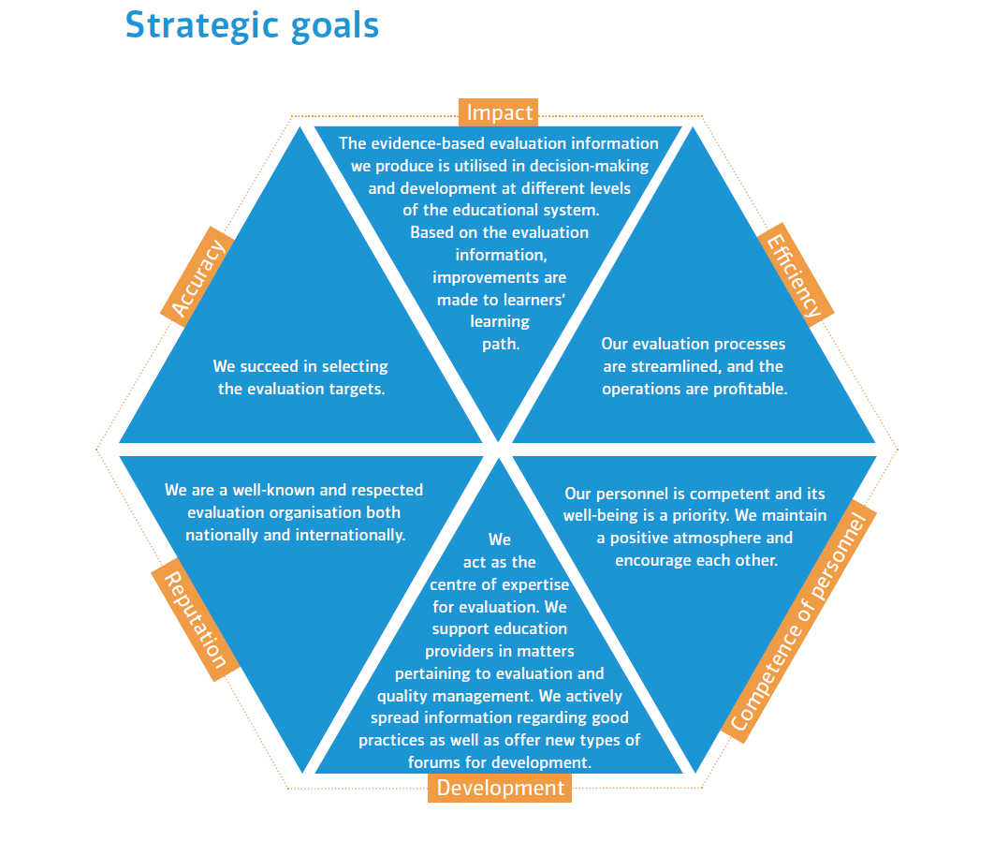

Slide 17
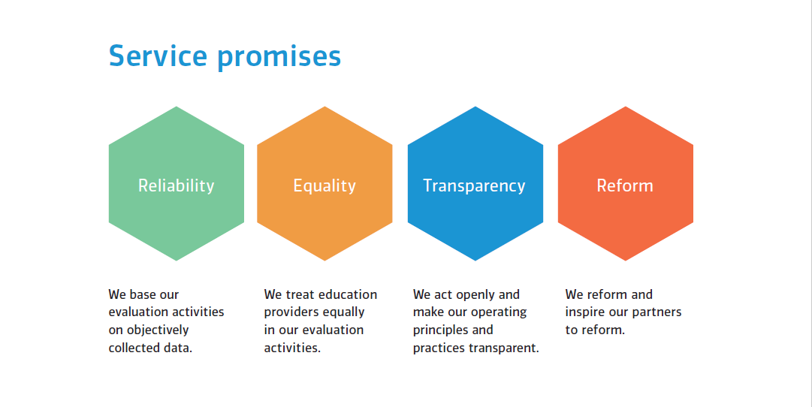

Slide 18
The National Education Evaluation Plan 2016-2019

Slide 19
The Evaluation Plan 2016-2019
Formulated by the Evaluation Council
FINEEC heard its key stakeholders in the process of preparing the plan
Approved by the Ministry of Education and Culture in March 2016

Slide 20
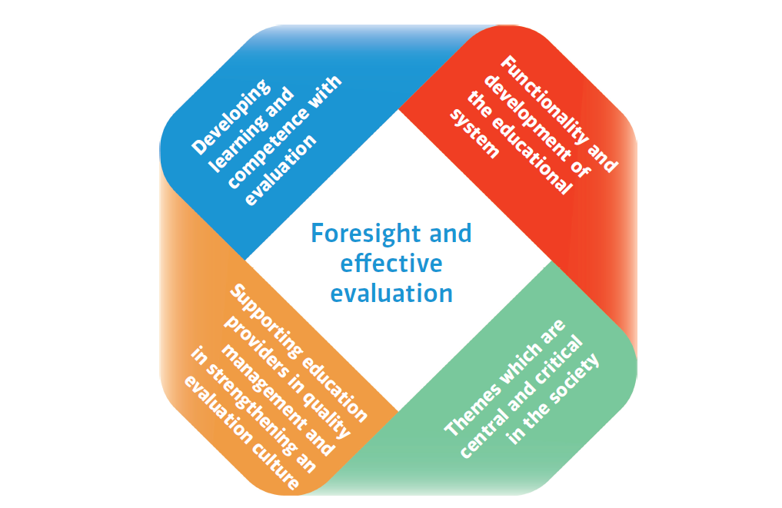
Focus areas of evaluation activities

Slide 21
Evaluations of early childhood and pre-primary education 2016-2019
The implementation and process of early childhood education
Supporting early childhood education providers in quality management and the development of an evaluation model

Slide 22
Evaluations of primary and secondary education
Assessment of Learning Outcomes
    Mathematics, Mother tongue (Finnish and Swedish) periodically
    Sample-based assessments
    No ranking lists
    Control concerning equal educational opportunities (gender, place of residence, home background)

Slide 23
Examples of evaluations of primary and secondary education 2016-2019:
Assessments of learning outcomes
  Finnish as a second language
  Sami language
  Finnish sign language
  Romany language
  Longitudinal assessment in mathematics
  Bilingualism and multilingualism in Swedish-speaking schools

Slide 24
Evaluations of vocational education and training 2016-2019
Assessments of learning outcomes (e.g.):
  Vehicle technology
  Information technology
  Music
  Textiles and clothing
  Youth and leisure instruction
  Processing industry
  Audio-visual communication

Slide 25
Evaluations of vocational education and training 2016-2019
Meta-evaluation of the assessment of learning outcomes and developing the evaluation system
Evaluation of the revision of the vocational qualification requirements
Supporting education providers in quality management and evaluation
External evaluation of quality management systems

Slide 26
Evaluations of higher education 2016-2019
Quality system audits
  Universities and universities of applied sciences
Engineering programme accreditations
  EUR-ACE
Theme evaluations
  e.g. Maritime education, Swedish teacher education programmes

Slide 27
Cross-sectoral and thematic evaluations 2016-2019
Examples:
  The impact of national budget cuts on educational and cultural rights (early childhood → secondary education + art and adult education)
  Peaceful and safe learning environments in schools and educational institutions (early childhood → secondary education)
  Integration of immigrants to the educational system (early childhood → adult education)

Slide 28
Cross-sectoral and thematic evaluations 2016-2019
Examples (continued):
  Students’ transitions and study paths at educational transition points (primary → adult education)
  Entrepreneurship and innovative capacity (vocational → higher education)
  Changes in the role of teachers; an evaluation of teacher training and continuing education (early childhood → higher education)

Slide 29
International activities of FINEEC

Slide 30
International activities
ENQA – European Association for Quality Assurance in Higher Education (FINEEC’s external review in 2016)
EQAR – European Quality Assurance Register for Higher Education
NOQA, INQAAHE – International networks for external quality assurance agencies
EUR-ACE – European Accreditation of Engineering Programmes
Quality Audit Network
Twinning projects (higher education) in Armenia and Azerbaijan
Nordic Council of Ministers (Conference on June 14, 2016!)
Nordiska evalueringsnätverket
Nordiska nätverket för prov och bedömning
PISA, Pirls, TIMMS etc.

Slide 31
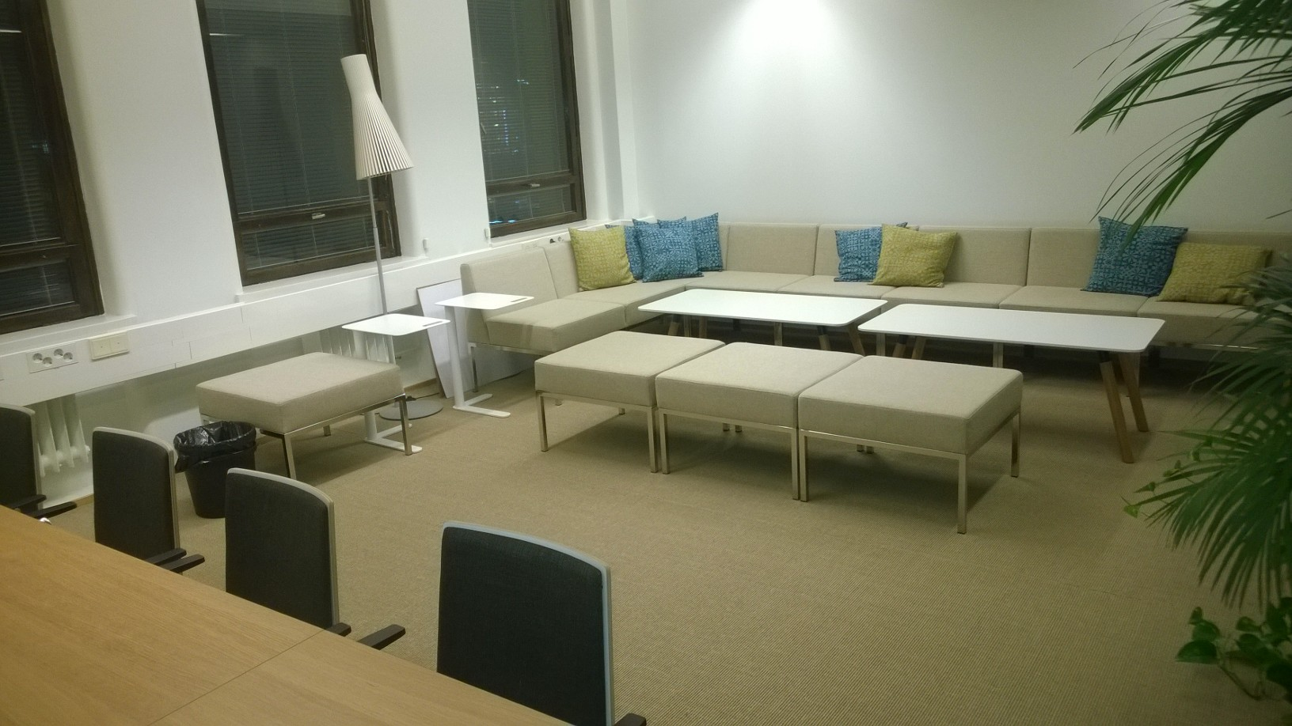

Slide 32
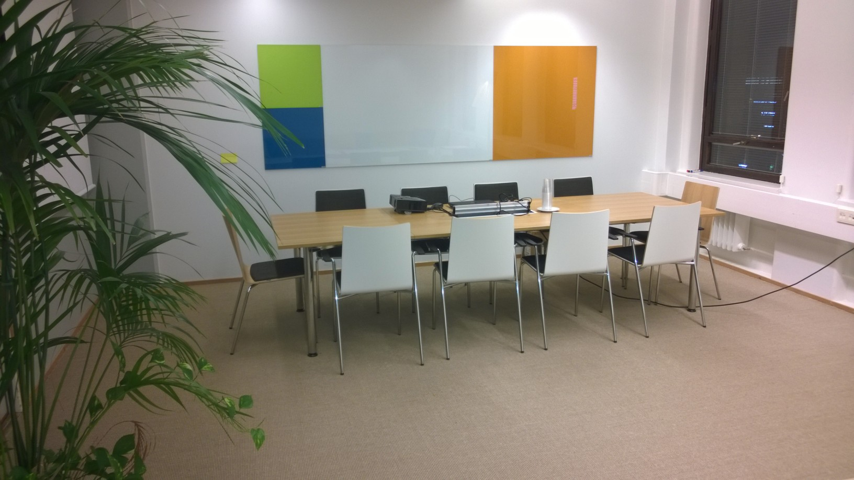

Slide 33
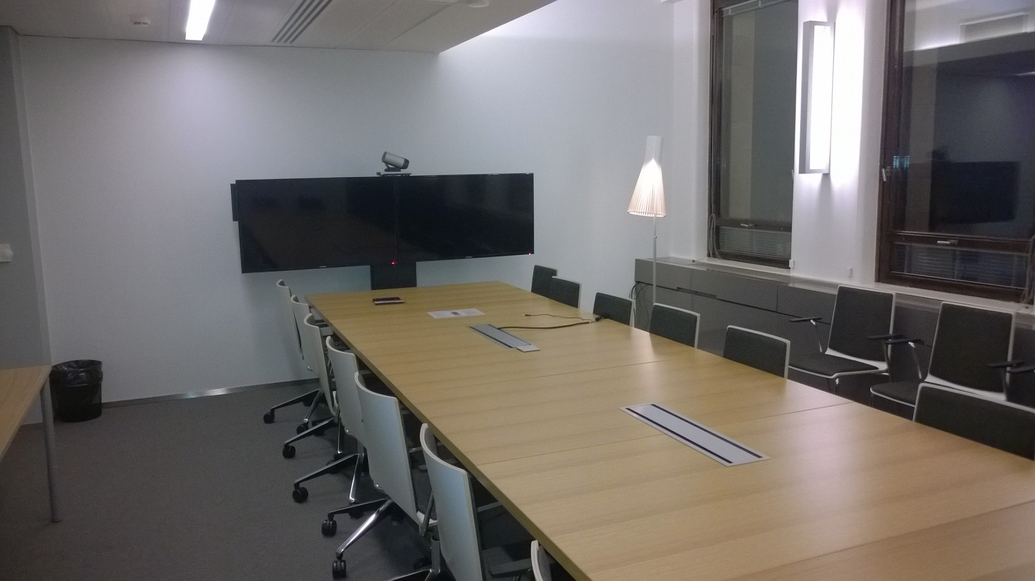

Slide 34
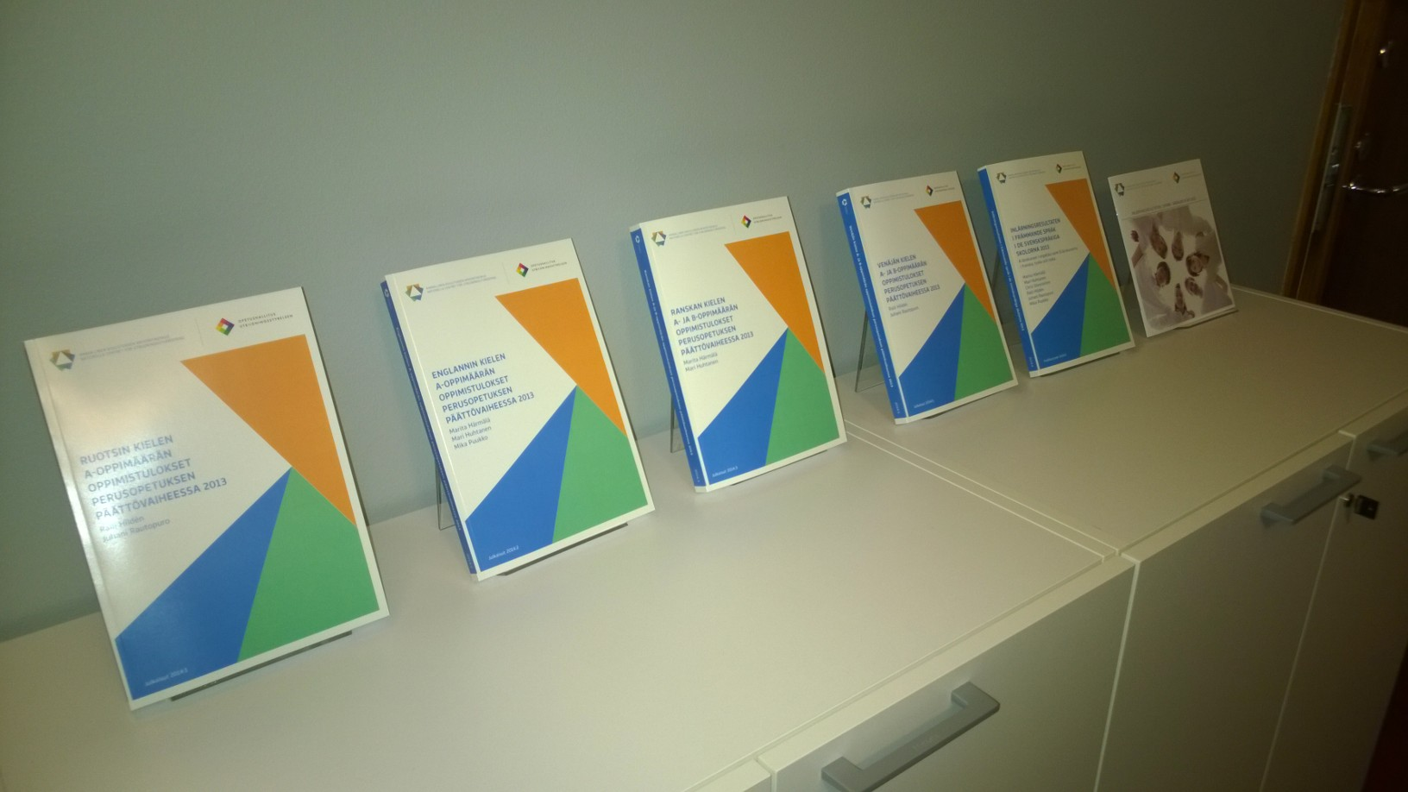

Slide 35
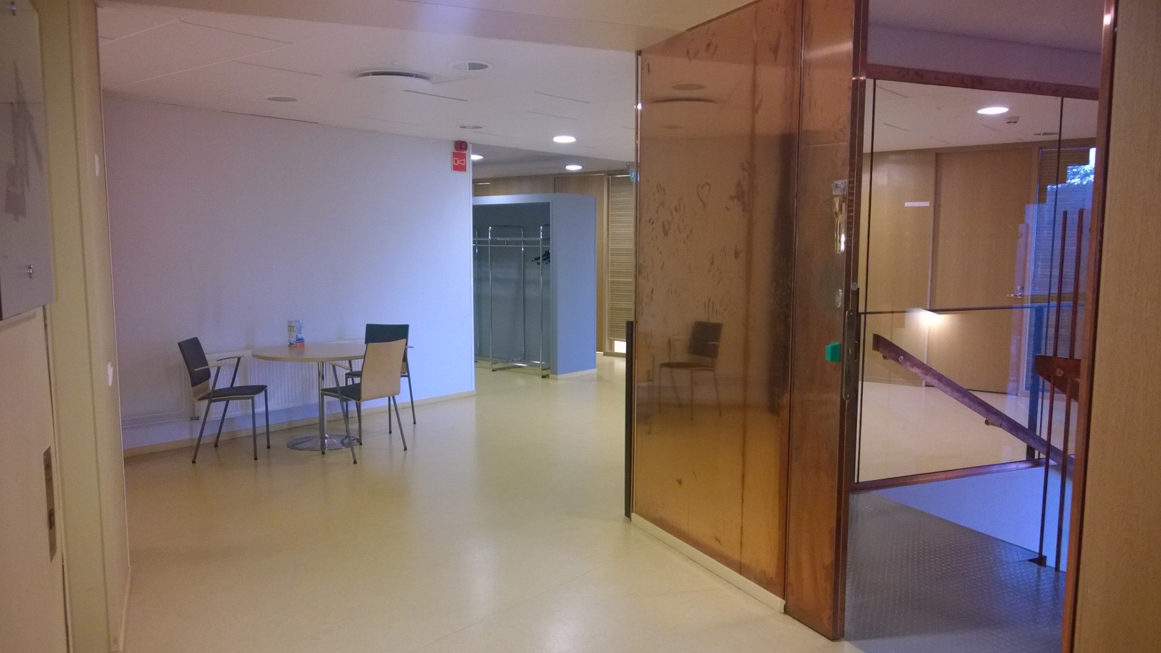

Slide 36
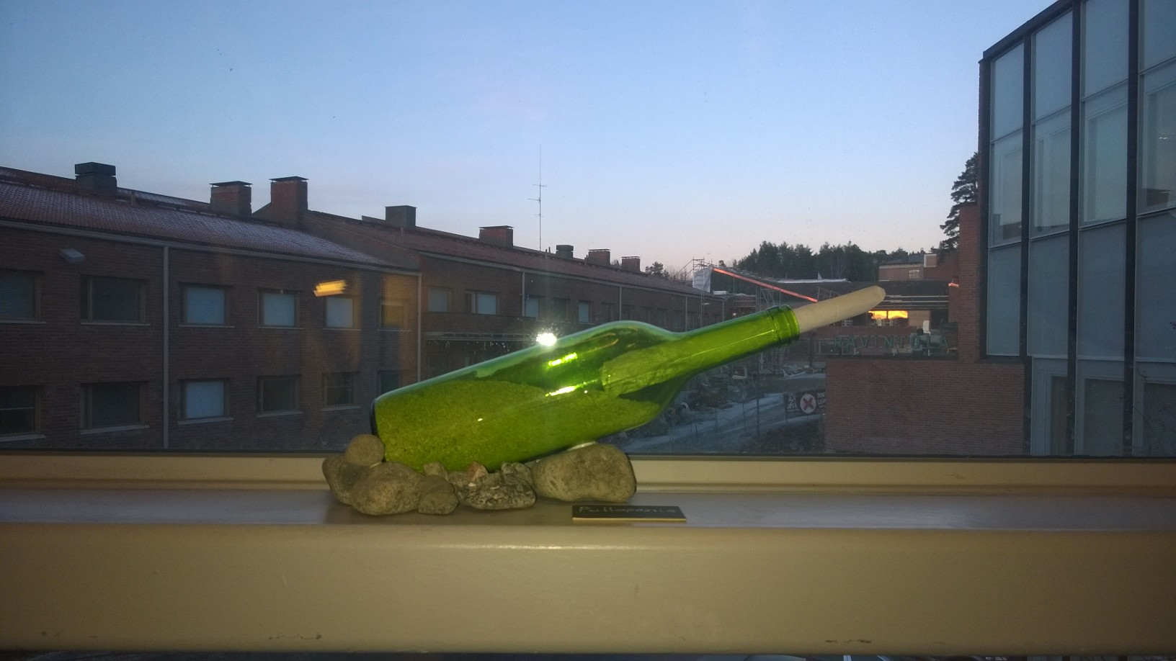

Slide 37
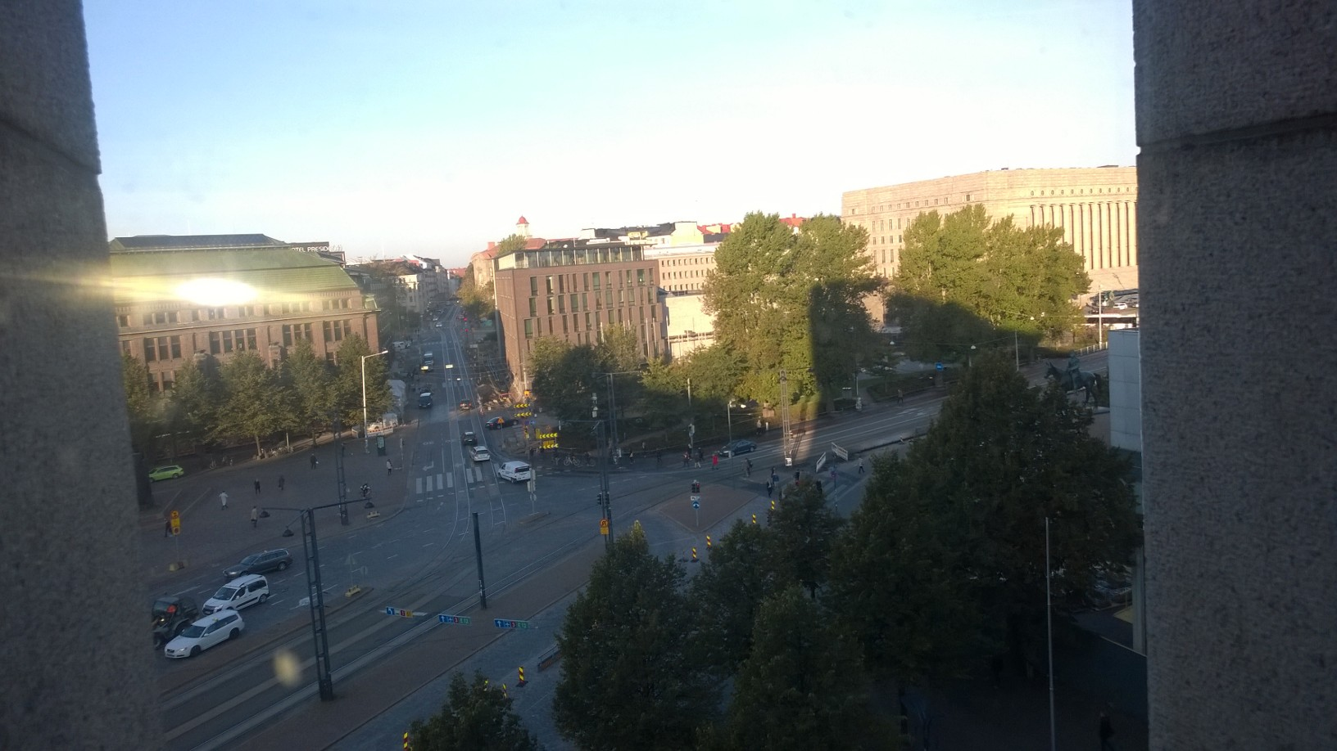




www.karvi.fi
Thank you!

