Slide 1

Higher Education
Evaluations -
Audit model
Helka Kekäläinen, PhD, Head of Unit
16.5.2016 Armenian visit

Slide 2
WARMLY WELCOME TO FINEEC!

Slide 3
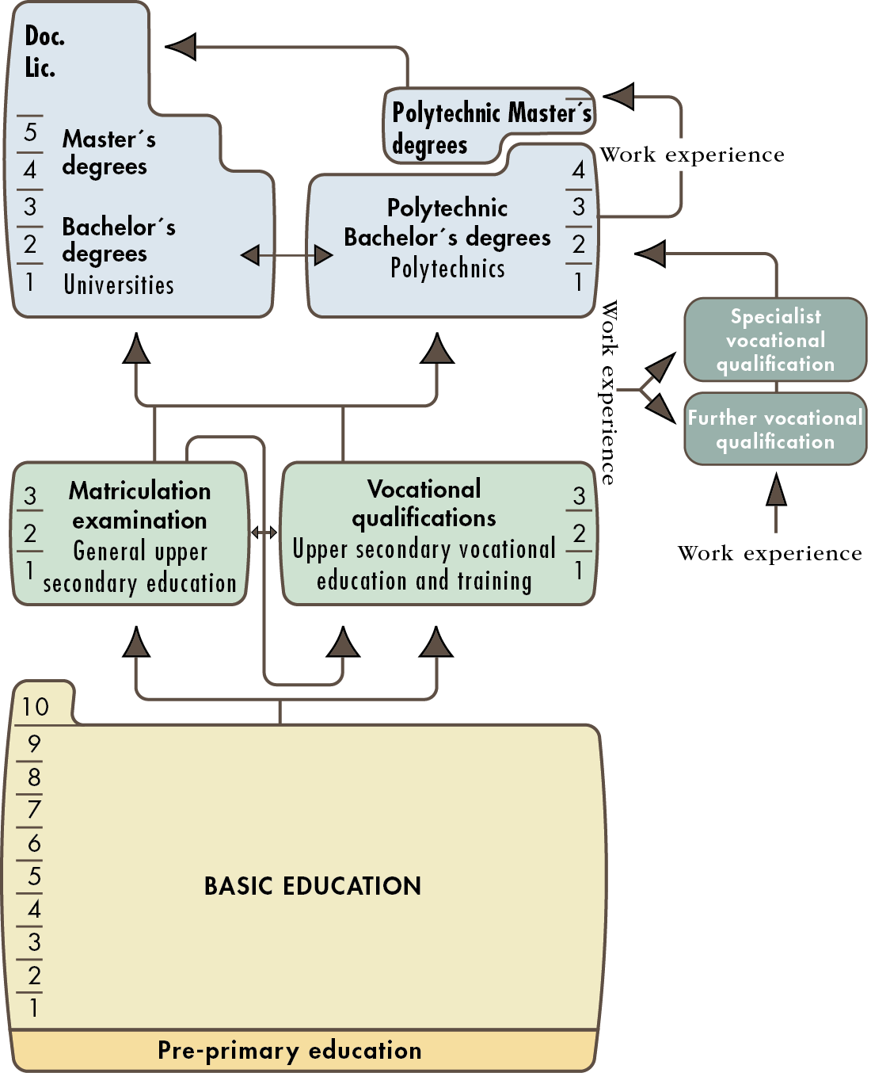

Slide 4
EVALUATIONS OF HIGHER EDUCATION BY FINEEC
Audits of Quality Systems of HEI`s
Universities and Universities of Applied Sciences
Since 2005, all the institutions audited at least once
Thematic evaluations
  Study paths and working life co-operation between vocational education and training and professional higher education (ongoing)
  Subject teachers of Swedish language (ongoing)
Evaluations of educational fields
Education and training in early childhood education
Voluntary Engineering Programme Accreditations (EUR-ACE)

Slide 5
OTHER ACTIVITIES OF HIGHER EDUCATION UNIT 2014 -
INTERNATIONAL PROJECTS
Twinning Project: Empowerment of the Tertiary Level Education of the Republic of Armenia for European Higher Education Area Integration “EHEA”
Twinning Project: Support to the Ministry of Education of the Republic of Azerbaijan for Further Adherence of the Higher Education System to the European Higher Education Area (AZ-ad-EHEA)

Slide 6
INTERNATIONAL ACTIVITIES
ENQA – European Association for Quality Assurance in Higher Education (Board member 2008, Vice-President 2010- )
EQAR – European Quality Assurance Register for Higher Education
NOQA, INQAAHE – international networks for quality assurance agencies
EUR-ACE – European Accreditation of Engineering Programmes

Slide 7
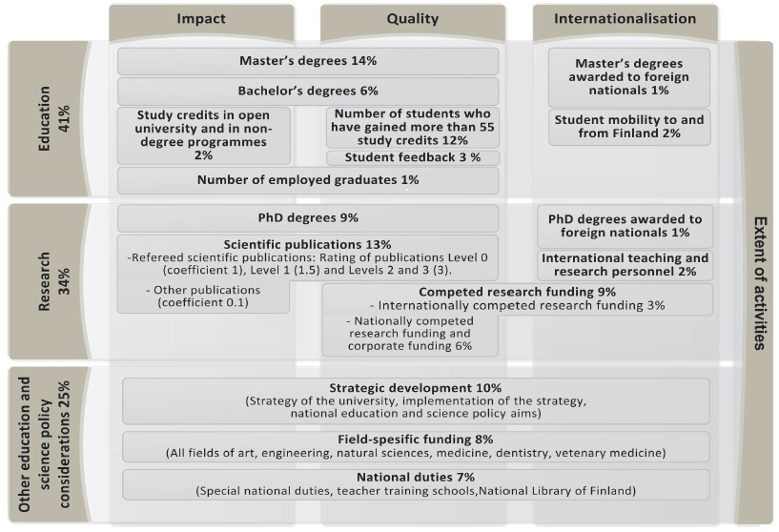
FUNDING MODEL OF UNIVERSITIES

Slide 8
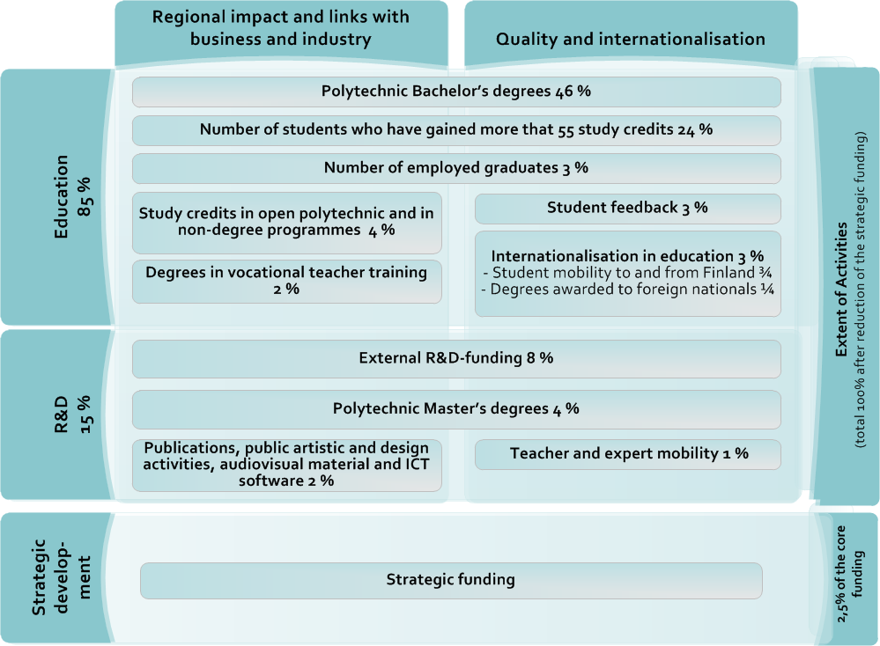
FUNDING MODEL OF UAS’S

Slide 9
FINEEC AUDITS AND
THEIR IMPACT ON
HIGHER EDUCATION

Slide 10
FINEEC AUDIT – BACKGROUND AND PHILOSOPHY
Finland’s response to the request of the Bologna process to develop a comprehensive national higher education QA system (”system of accreditation, certification or comparable procedure”)
Institutional approach – the same model for both higher education sectors (universities and universities of applied sciences)
  Comprehensive approach – covers research/RDI, education and social impact – and overall quality management
External assessment of internal QA - reflects institutions’ autonomy and responsibility, and a large measure of trust
  HEIs are responsible for the quality of their operations
  Each institution develops its quality system based on its own needs and goals

Slide 11
ENHANCEMENT-LED APPROACH
Aim to support HEIs in the enhancement of quality and establishment of quality culture by
producing information to assist HEIs to develop their activities, and by
(2) exchanging and disseminating good practices among other HEIs
As a result of the audit, an institution either passes the audit and receives a quality label or is subject to a subsequent re-audit
  Institutions are neither rewarded for a positive result nor punished for a negative one – there are no financial incentives or loss of degree-awarding powers

Slide 12
AUDIT MANUAL: PROCESS AND CRITERIA
Audits are based on FINEEC Audit Manual (process and criteria)
http://karvi.fi/app/uploads/2015/02/KARVI_0215.pdf
Full cycle of audits conducted during the years 2005-2012, the second audit round going on (until 2018)
  Feedback from the audited Finnish HEIs shows that they have been quite satisfied with the audits
  The model refined four times
  Well-established and stable procedure
Impact studies, institutions’ feedback and follow-up reports: Improvement of management and feedback systems as well as results of activities, new operational and quality cultures in HEIs

Slide 13
AUDIT TARGETS
1. Quality policy
4. Quality management of the HEI’s core duties, incl. essential services supporting these
5. Samples of degree education (3 programmes)
2. Quality system’s link with strategic management
3. Development of the quality system
6. The quality system as a whole
4b) RDI & artistic activities
4c) Societal inter-action and regional development work
4d) Optional audit target
4a) Degree education

Slide 14
CRITERIA USED IN THE AUDIT
Audits employ a set of criteria that is based on a scale of four development stages of quality management
  absent
  emerging
  developing
  advanced
The development phase for each audit target is determined individually, including each degree programme sample
The audit team can propose that the institution passes the audit if none of the targets are ‘absent’ and if the quality system as a whole is at least ‘developing’

Slide 15
AUDIT TARGET 6. THE QUALITY SYSTEM AS A WHOLE

Slide 16
AUDIT PROCESS
Agreement negotiation
Preliminary time frame for the audit
Self-evaluation
Compilation and submission of other audit material
Audit visit
Audit team’s report and recommen-dation regarding the audit result
Publication of the report
Quality label – valid for 6 years
Concluding seminar at the HEI
Higher Education Evaluation Committee appoints the audit team.
Higher Education Evaluation Committee makes the decision on the result.
If the HEI does not pass the audit, re-audit in 2-3 years
Feedback from the HEI and audit team
Next audit in 6 years
Follow-up seminar 3 years after the audit

Slide 17
AUDIT MATERIAL
Basic material
Self-evaluation report
  The report is structured according to FINEEC guidelines
  The structure mirrors the audit criteria, the length is limited
  Each chapter ends with a summary table of strengths and areas in need of development, as recognised by the institution
Electronic materials
Interviews
Requested additional material

Slide 18
FINEEC AUDIT TEAMS
An audit team usually consists of five members
  In case of bigger institutions, can be up to seven members
Selected so that they represent
the two higher education sectors (research universities, professionally oriented HEIs)
students
working life outside the higher education sector
Experience and knowledge of the optional audit target

Slide 19
AUDIT AGREEMENT
FINEEC signs an agreement on the audit with the HEI
The following issues are recorded in the agreement:
͘͘ Audit targets (incl. the optional target)
͘͘ Audit procedure and time frame
͘͘ The national or international composition of the audit team and the language to be used to carry out the audit (Finnish, Swedish or English)
͘͘ Duration of the audit visit (3–5 days)
͘͘ Price of the audit (costs are shared between FINEEC and HEI)
͘͘ Commitment to a potential re-audit

Slide 20
FINEEC´S HIGHER EDUCATION EVALUATION COMMITTEE
Committee has 9 members: HEIs, students, working life represented
Professor Jouni Välijärvi, University of Jyväskylä/Chair
Rector Anneli Pirttilä, Saimia UAS/Vice Chair
Decides on Audit manual, audit teams and audit outcomes
Approves the project plans, planning groups and evaluation teams of evaluations that concern higher education

Slide 21
OUTCOME OF AN AUDIT
The FINEEC Higher Education Evaluation Committee decides on the audit result on the basis of the proposal by the audit team and on the audit report
The task of the Committee is to ensure that decisions are impartial
HEIs that pass the audit receive a quality label and are added to the register of audited institutions maintained on FINEEC’s website
http://karvi.fi/en/higher-education/audits-quality-systems/audit-register/

Slide 22
GENERAL REMARKS ON THE FIRST AUDIT ROUND
Nearly one in five audits (18%) resulted in a re-audit decision
  14% of the UASs vs. 24% of the universities
Feedback from the audited HEIs
  On the whole, HEIs quite satisfied with the audits; satisfaction remained relatively constant throughout the first audit round
  UASs slightly more satisfied than universities
  The management and central administration had the most positive view on the quality work in both higher education sectors

Slide 23
HEIS’ VIEWS ON THE IMPACT OF THE AUDIT
Improvement of management systems, strengthening of strategic work
Several UASs report on the link between the quality system and the improved results of their activities (regarding, e.g., dropout rate, progression and completion of studies)
Improvement of feedback systems (student, working life and alumni)
Participation of students and external stakeholders in the development of operations enhanced and supported
Dissemination of good practices within and between HEIs
More cooperation within institutions between different units and between HEIs, benchmarking activities have increased
New evaluation cultures – external evaluations now seen as more significant tools in the development (international evaluations utilised at different organisational levels)

Slide 24
CONCLUSIONS
Audits as enhancement-led evaluations have received wide acceptance
  Mutual trust
  Open and supportive communication
Audits have contributed to the development of Finnish higher education by
  Changing quality and operational cultures in HEIs and by increasing cooperation within the whole field of higher education
  Inclining HEIs to learn from one another and share information and good practices with one another, also between the two higher education sectors – mutual understanding and collaboration between the sectors have been enhanced

