Slide 1


European Style Pilot Evaluations in Azerbaijan Higher Education Baku 20 June 2017 Helka Kekäläinen, PhD Project Leader

Slide 2
Aim of the Component 4:
Result 4: Standards and Guidelines for Quality Assurance in HE in Azerbaijan are developed in line with the European Standards and Guidelines for QA and tested with three HE institutions.
Pilot institutions:
Azerbaijan State Economic University UNEC
Azerbaijan State Pedagogical University ASPU
Azerbaijan Technical University AzTU

Slide 3
Main Activities in Component 4:
Trainings for the EHEA context, ESG and EHEA trends and practices
Drafting the Standards and Guidelines for Quality Assurance in Azerbaijan
Fostering the Self-Evaluation Capacity in 3 Pilot institutions
The test run of the Standards and Guidelines with 3 universities in Azerbaijan

Slide 4
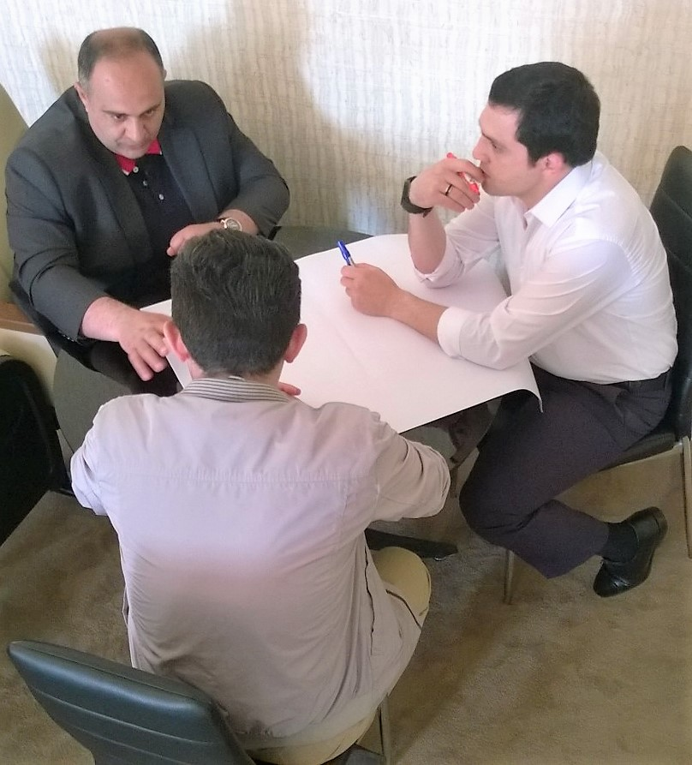
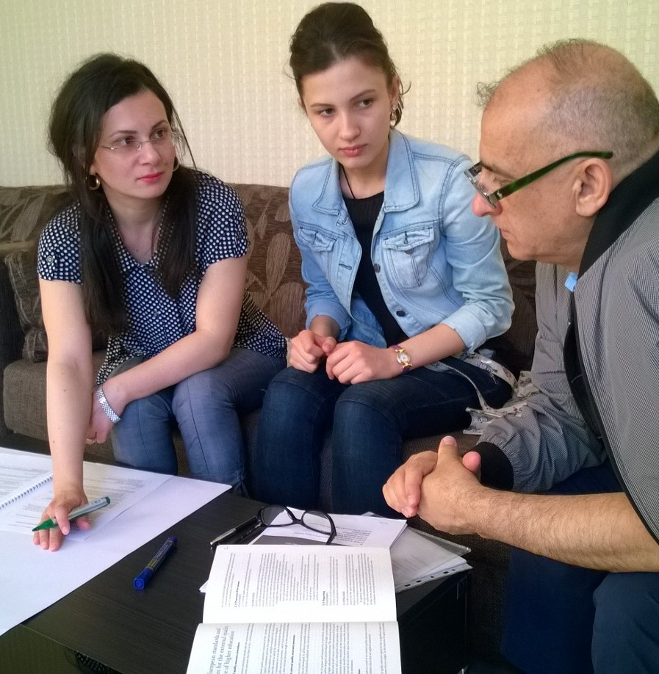
DRAFTING STANDARDS IN QUBA

Slide 5
Aims of the institutional evaluation
Support the strategic management of the higher education institution
Provide external feedback to the institution’s own internal quality assurance procedures
Inform all stakeholders of the compliance of the process and outcomes of teaching and learning to the European standards and guidelines for quality assurance in higher education, ESG.

Slide 6
ASSESMENT AREAS
I. STRATEGIC PLANNING
II. MANAGEMENT
III. HUMAN RESOURCES
IV. STUDY PROGRAMMES AND THEIR DEVELOPMENT
V. STUDENTS
VI. RESEARCH ACTIVITIES
VII. TEACHING AND LEARNING RESOURCES AND SUPPORT SERVICES

Slide 7
Outcome of the institutional evaluation
The outcome of the Pilot Evaluation
will be a public report identifying
strengths and good practices
of the university
and giving recommendations
for improvement.

Slide 8
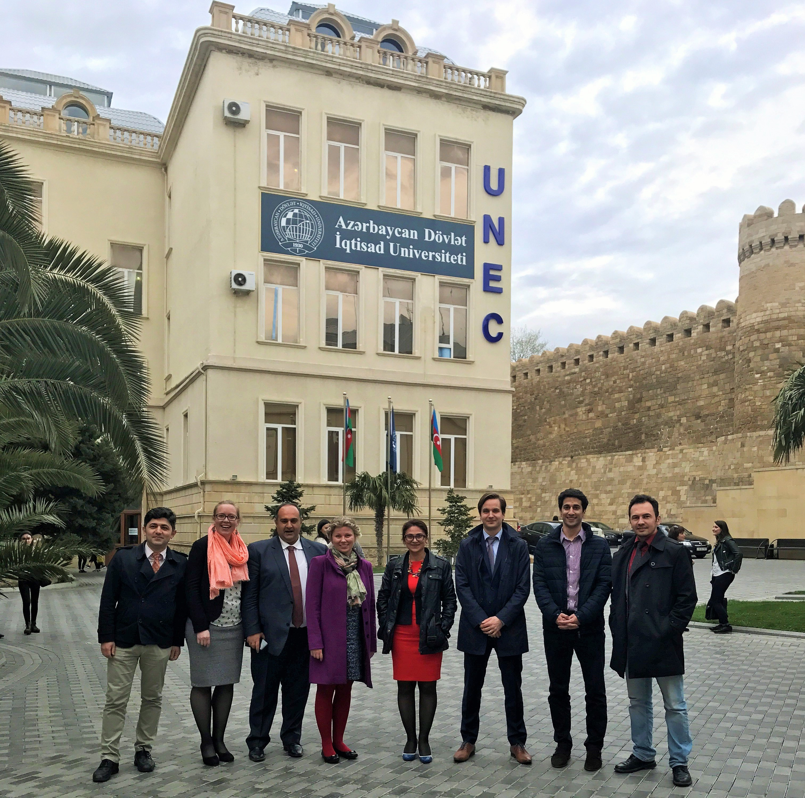
V
I
S
I
T

Slide 9
Summary of assessment of 3 Pilots:
 | Fully conforms to requirements | Mostly conforms to requirements | Partially conforms to requirements | Does not conform to requirements
1. Strategic planning |  |  | X X X
2. Management |  | X | XX
3. Human resources |  | X X | X
4. Study programmes and their development |  |  | X X X
5. Students |  | X X | X
6. Research activities |  | X | X | X
7. Teaching and learning resources and support services |  | X X | X

Slide 10
OVERALL STRENGTHS
The roles and focuses of the universities – pedagogy, economy, technology – are clear and well justified
Willingness to improve, awareness of the need for change
Orientation towards improving the management structure and create conditions for the senior management staff to take more responsibility and ownership in fulfilling their role
Awareness of the need to improve management and leadership competences.

Slide 11
OVERALL AREAS OF IMPROVEMENT
The universities should work on its mission and vision statements and general objectives, which could be more academic in content and which lay down the general framework for the strategic choices.
All the relevant stakeholders should be taken along to the strategy process in the future. The universities should pay more attention to inform all stakeholders about the strategic development plan and the objectives.

Slide 12
OVERALL AREAS OF IMPROVEMENT
Even if the management and staff are aware of the needs to monitor changes in the labour market, the needs of the society, and the need to involve more stakeholders, addressing those needs requires a more systematic and efficient approach.
Management of lower level is very fragmented – very many positions and duties. There is too much focus on rector’s level – middle management level does not work properly.

Slide 13
OVERALL AREAS OF IMPROVEMENT
Reviewing of study programmes and syllabuses should be conducted regularly. Students and external stakeholders should be involved in these reviews.
The improvement of teaching staff’s competencies as well as the monitoring of the improvement should be systematic.
More emphasise should be given to the relevance of up-to-date teaching materials, technical resources should be improved and the efficient use of technical equipment in the teaching and learning process assured.
Learning outcome based and student-centred approach in teaching and learning need to be developed.

Slide 14
OVERALL AREAS OF IMPROVEMENT
Establishing systematic mechanisms that support the staff in conducting research activities. The change from teaching mind set to research mind set should be prioritized. Access to international research databases is integral to improving research activities. Courses and training on research methodologies and skills should be offered to students.
Internationalization is a challenge at all levels – better English language skills, at least one full course in English, participation in exchange programmes (both, academic staff as well as students), international research projects etc.

Slide 15
OVERALL AREAS OF IMPROVEMENT
The distribution of full-time teaching staff by age is uneven. More younger, qualified and motivated teachers and researchers are needed in order to facilitate the improvements in the area of higher education.

Slide 16
RECOMMENDATIONS AT THE STATE LEVEL
The legal and normative framework which regulates governance of higher education institutions should be reconsidered by the Ministry of Education to allow universities to implement a more effective management system, e.g., have two different governing bodies – academic council and operational management body.
Higher education institutions should be granted more freedom and autonomy to continuously modify and update the curricula of their study programmes according to needs of labour market and based on recent research results.

Slide 17
RECOMMENDATIONS AT THE STATE LEVEL
Doctoral studies should be reorganised based on the Bologna system, as the 2-level system of doctoral degrees is demotivating and may cause losing the interest of young generation to start their academic career.
Access to up-to-date academic research through electronic databases should be ensured at all Azerbaijani higher education institutions.

Slide 18
RECOMMENDATIONS AT THE STATE LEVEL
For internationalisation of higher education and in order to become part of international research community, the English language competences should be raised already at the level of secondary education. National curriculum should be reconsidered having stronger emphasis on acquiring English language skills.

Slide 19
MAIN FINDINGS FOR THE FUTURE:
ESG is applicable in Azerbaijan
Azerbaijani Universities are ready for more development oriented and less control driven system
Self-evaluation capacity of pilot institutions was positive surprise
Azerbaijani students gave important output in the pilots as experts and should be included in future external quality assurance as equal evaluators

Slide 20
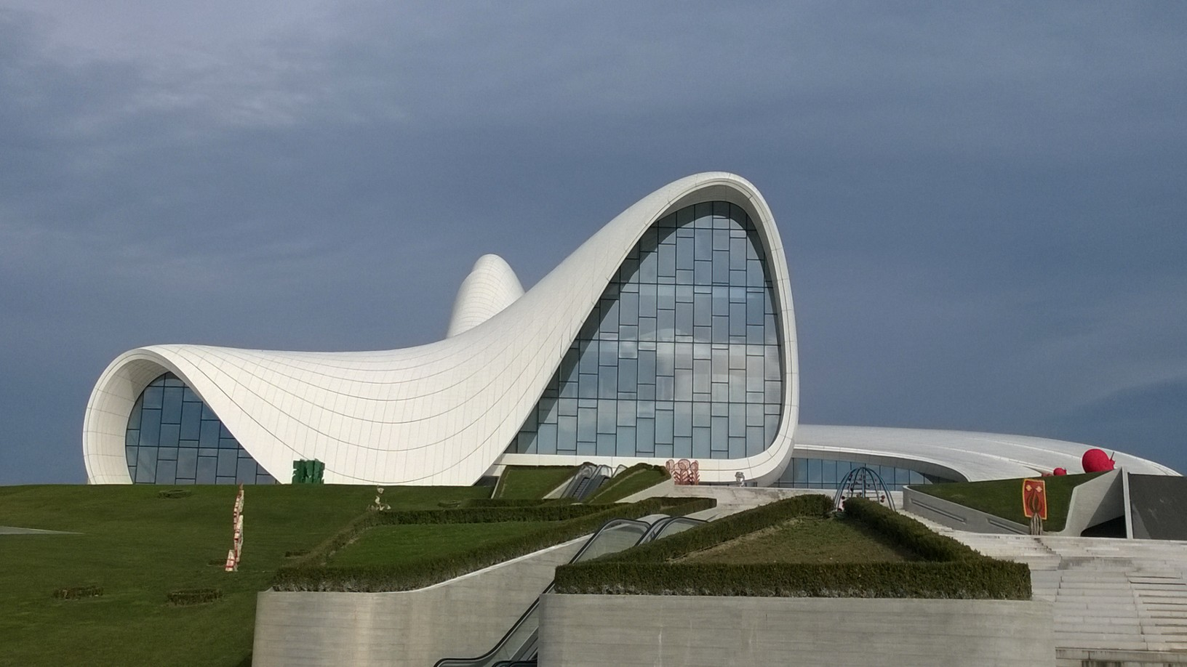
Thank you!

