Slide 1


Key Results of the Twinning
Project AZ-ad-EHEA
Baku 29 August 2017
Helka Kekäläinen, PhD
Heli Mattisen, PhD
Project Leaders

Slide 2

Aims of the Twinning Project
Enhancement of Azerbaijan´s higher education system through its integration with the European Higher Education Area (EHEA).
The establishment of EHEA compliant quality assurance system that will facilitate mobility within the EHEA, support the recognition of qualifications and increase employability of graduates.
To assist the development of Bologna related policies and the implementation of the EHEA objectives and reference tools by Ministry of Education and other key institutions of the Republic of Azerbaijan.

Slide 3
Co-operation for Sustainable Results
Key figures of the project –
Number of trainings/workshops – 132
Number of local participants (persons) – 602
Number of active local participants 100+ (over 5 participations)
Number of international experts involved 33
Number of expert mission days 500+
Number of study visits 2, number of partipants 12
Number of internships 2, number of participants 2
Number of universities involved - 13

Slide 4
Translations
47 legal documents have been translated from Azerbaijani into English
46 documents have been translated from English to Azerbaijani
All translations are available in the project web-site: www.ehea.edu.az

Slide 5
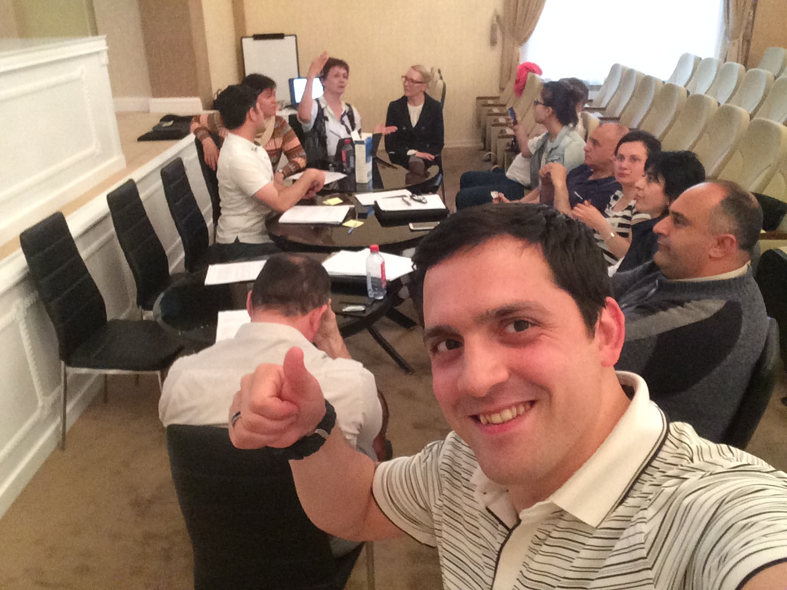
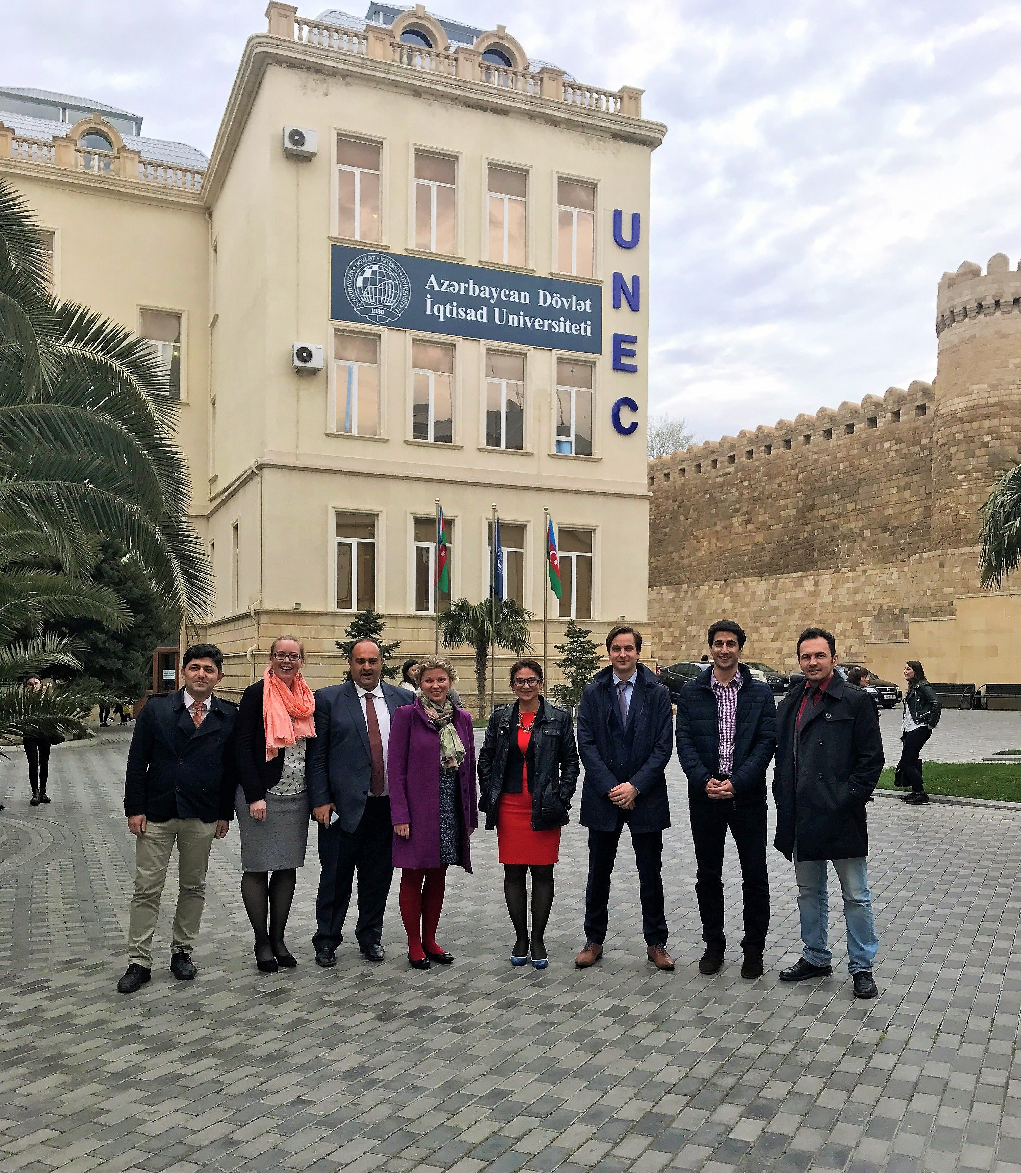
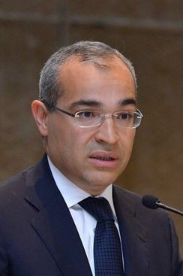
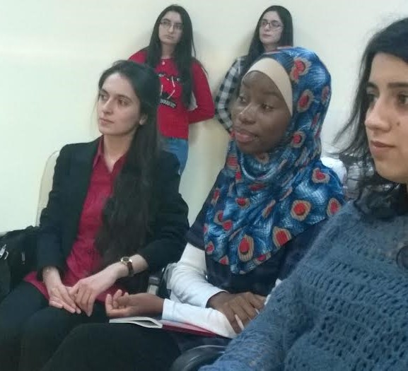
Co-operation for Sustainable Results

Slide 6
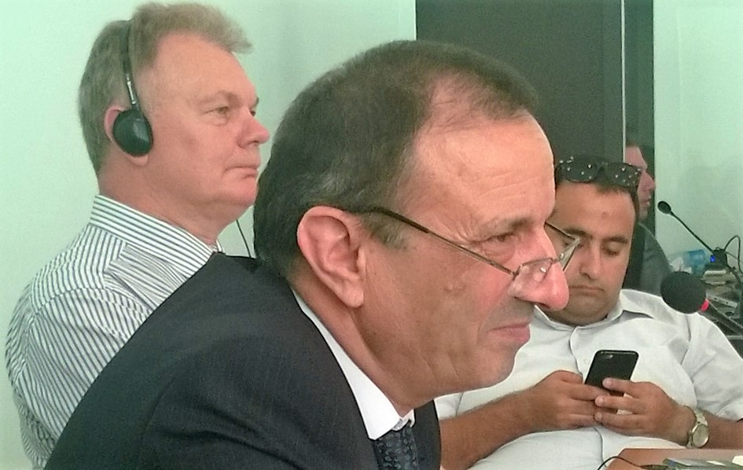
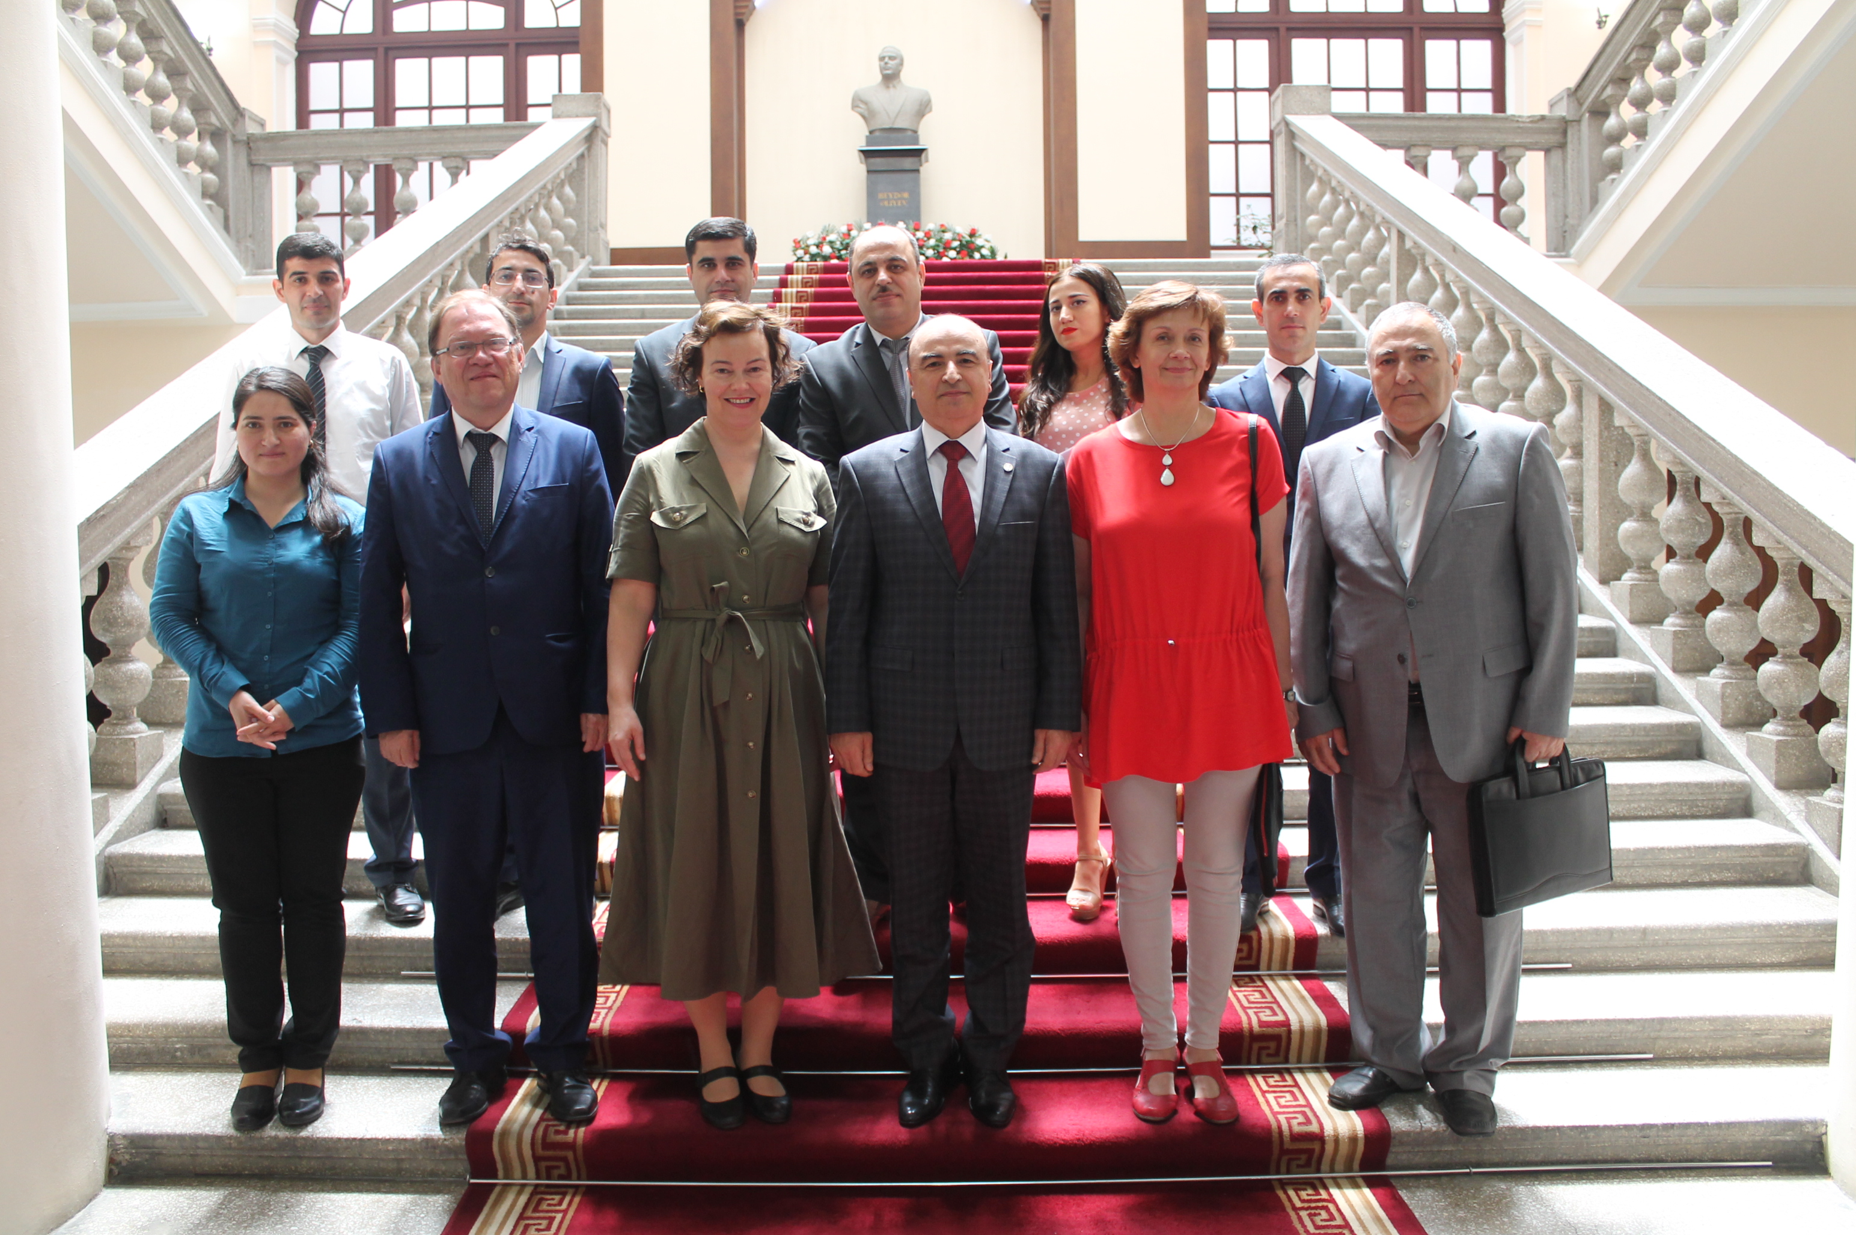
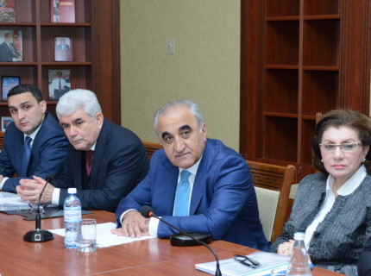
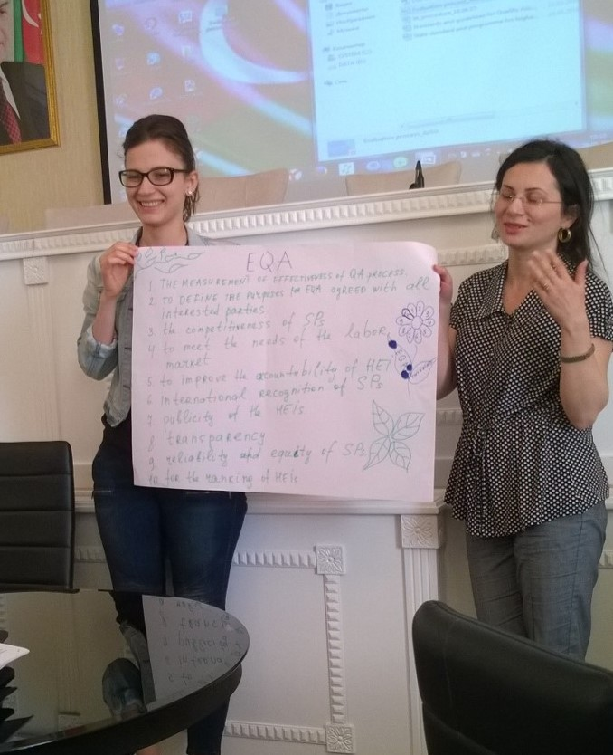
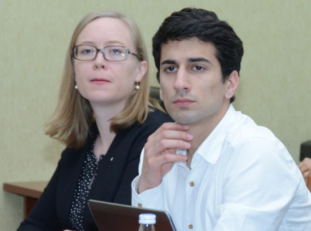
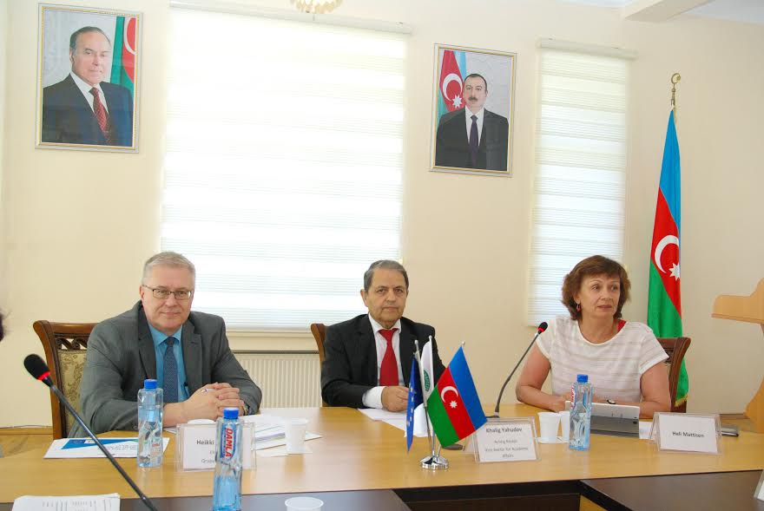
Co-operation for Sustainable Results

Slide 7

Main Outcomes: Component 1
Component Leader Sille Uusna
Comparison table on AzHE legislation and Bologna frame and drafted a gap report
Recommendation on the hierarchical structure of the HE legislation
Recommendations on new draft State Standards of higher education
Recommendations on new draft statutes of HEIs
Recommendations on draft rules of accreditation
Recommendations on accreditation standards for evaluating HEIs.

Slide 8
Main Outcomes: Component 2
Component Leader Kauko Hämäläinen
MoE has established the Erasmus+ and EHEA expert group as operational network of Bologna experts
Progress Review report on the implementation of the Bologna/EHEA process in Azerbaijan
Recommendations on a roadmap for further action to improve the EHEA compliant higher education steering and coordinating
Recommendations on the establishment of a Rectors’ Conference
Proposal on a communication strategy.

Slide 9
Main Outcomes: Component 3
Component Leader Maiki Udam
Recommendations on the draft action plan of the implementation of the AzNQF in higher education
Recommendations on the secretariat for the coordination and management of the implementation of the AzNQF
71 Azerbaijan experts trained in learning outcomes in engineering, economics and teacher education
ANO staff trained in Lisbon Convention and recognition of foreign diplomas
Recommendations on updating foreign diplomas’ recognition procedures and practices
Recommendations on further development of doctoral programmes in line with the Law on Science and EHEA.

Slide 10
Main Outcomes: Component 4
Component Leader Kirsi Hiltunen
Proposal for the Azerbaijan Standards and Guidelines for QA
Training 50 Azerbaijan experts to know and apply the EHEA standards and guidelines of QA
Training the staff of the three pilot universities to make self-evaluation
Training Azerbaijan experts to act as evaluators in pilot evaluation teams
Consulting and training the staff of the ANO
Making institutional quality assurance evaluation in three Azerbaijan pilot universities.

Slide 11
Results of pilot evaluations
Assessment area | Fully conforms to requirements | Mostly conforms to requirements | Partially conforms to requirements | Does not conform to requirements
1. Strategic planning |  |  | X X X
2. Management |  | X | X X
3. Human resources |  | X X | X
4. Study programmes and their development |  |  | X X X
5. Students |  | X X | X
6. Research activities |  | X | X | X
7. Teaching and learning resources and support services |  | X X | X

Slide 12
Overall strengths
The roles and focuses of the universities – pedagogy, economy, technology – are clear and well justified
Willingness to improve, awareness of the need for change
Orientation towards improving the management structure and create conditions for the senior management staff to take more responsibility and ownership in fulfilling their role
Awareness of the need to improve management and leadership competences

Slide 13
Main areas for improvement
Involvement of all the relevant stakeholders into the strategy process
The improvement of teaching staff’s competencies; relevance of up-to-date teaching materials; regular reviewing of study programmes and syllabuses
Learning outcome based and student-centred approach in teaching and learning
Establishing systematic mechanisms that support the staff and students in conducting research activities; access to international research databases
Internationalization

Slide 14
Recommendations at the state level
Legal and normative framework which regulates governance of higher education institutions should be reconsidered by the Ministry of Education to allow universities to implement a more effective management system
More freedom and autonomy to continuously modify and update the curricula of their study programmes according to needs of labour market and based on recent research results
Doctoral studies should be reorganised based on the Bologna system
Access to up-to-date academic research through electronic databases should be provided
National curriculum of secondary education should be reconsidered having stronger emphasis on acquiring English language skills.

Slide 15
Main value of the project
Mapping the situation in HE (again ... ☺) in a comprehensive way
Realistic and applicable recommendations in line with EHEA widely discussed with and agreed by stakeholders
Supporting collaborative learning in the HE community of Azerbaijan
Supporting changes in mind-set regarding the autonomy of HEIs combined with a rigorous, meaningful and improvement led approach in quality assurance

Slide 16
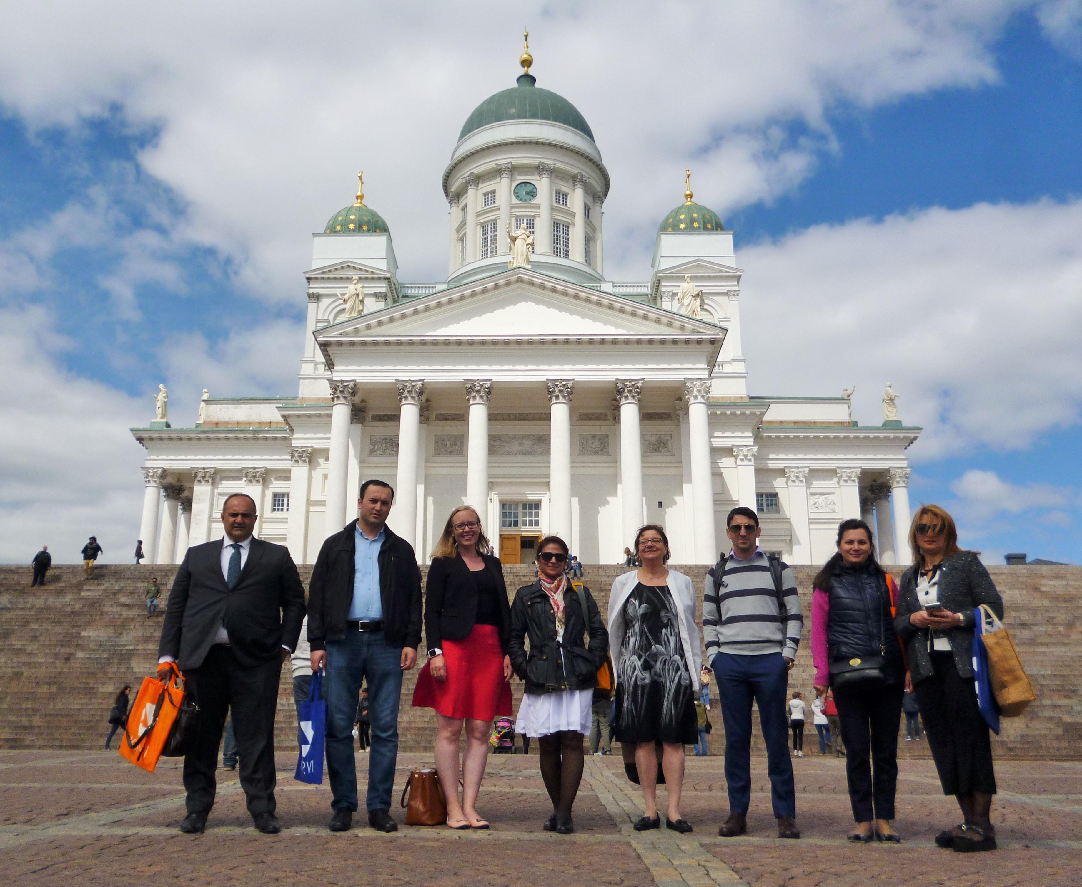
Thank you!

